Slide 1
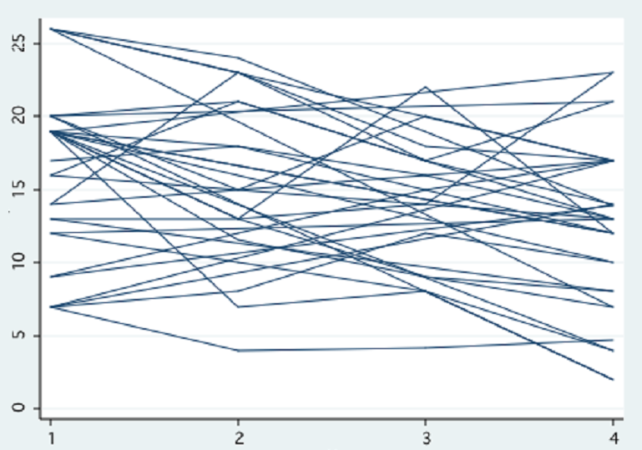
Modeling Normally Distributed Data with Repeated Measures by Olga Korosteleva, Ph.D. CSULB February 9, 2021, OCRUG

Slide 2
ABOUT ME
BS in Mathematics, Wayne State University, Detroit, MI, 1996
MS in Statistics, Purdue University, West Lafayette, IN, 1998
Ph.D. in Statistics, Purdue University, West Lafayette, IN, 2002
Professor of Statistics, CSU, Long Beach, 2002-present

Slide 3
SCHEDULE
6:40PM-7:30PM Mixed-effects Model for Normal Response, Example
7:30PM-7:50PM Mixed-effects Model Exercise
7:50PM-8:00PM Mixed-effects Model Exercise Solution
8PM-8:10PM Break
8:10PM-8:30PM Generalized Estimating Equations (GEE) Model for
Normal Response, Example
8:30PM-8:50PM GEE Exercise
8:50PM-9:00PM GEE Exercise Solution
9:00PM-9:30PM Additional Exercise + Solution
9:30PM-9:45PM Wrap-up

Slide 4

Greek Letters
Alpha $α$
Beta $β$
Epsilon $ε$
Rho $ρ$
Sigma $σ$

Slide 5
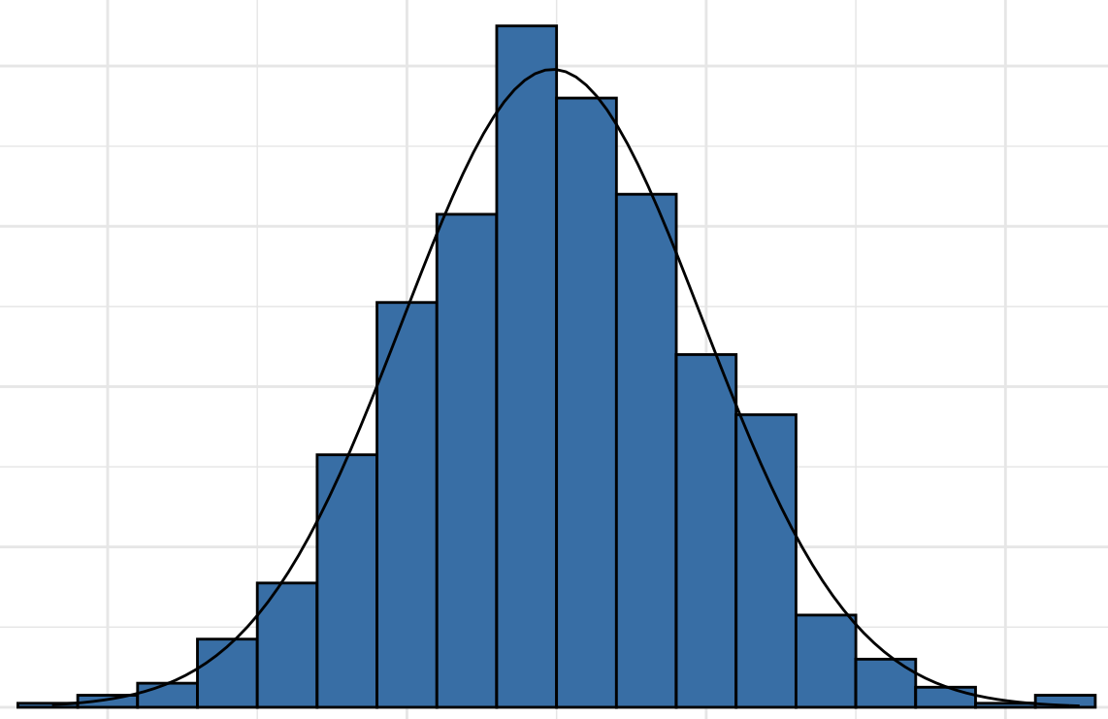
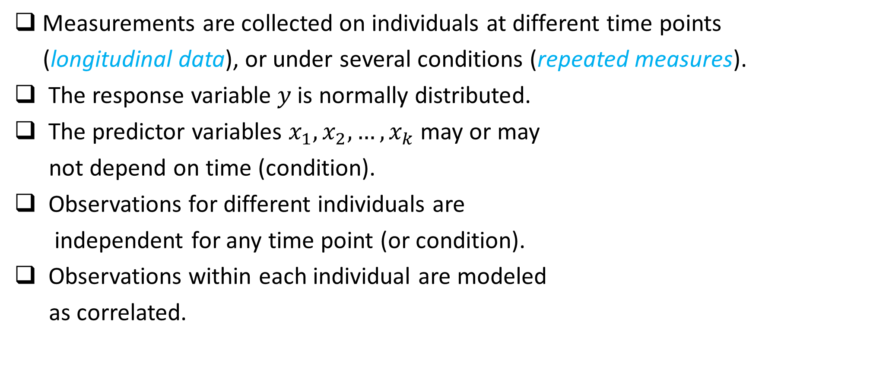
MIXED-EFFECTS MODEL FOR NORMAL RESPONSE: Setting Explained
Measurements are collected on individuals at different time points
(longitudinal data), or under several conditions (repeated measures).
The response variable $y$is normally distributed.
The predictor variables $x_{1}, x_{2}, …, x_{k}$ may or may
not depend on time (condition).
Observations for different individuals are
independent for any time point (or condition).
Observations within each individual are modeled
as correlated.

Slide 6
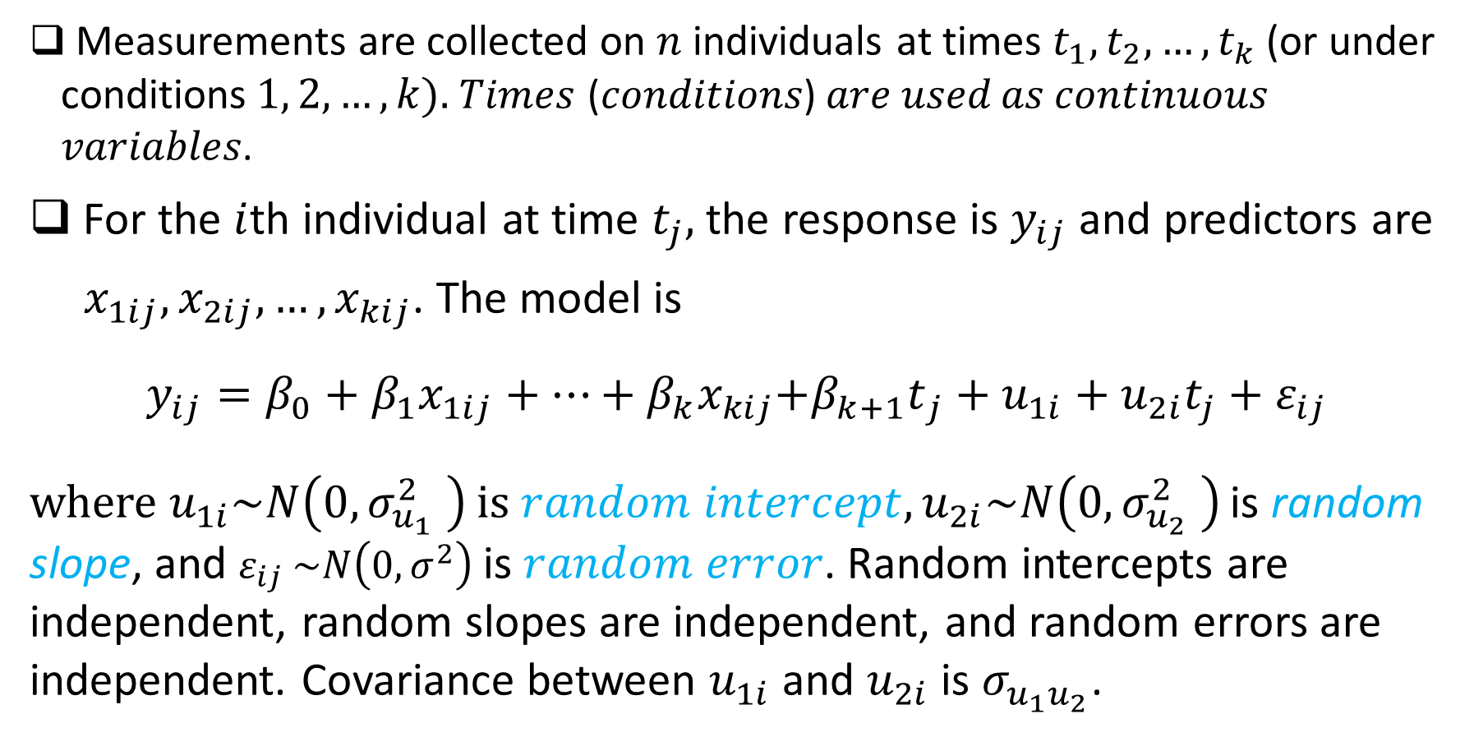
MIXED-EFFECTS MODEL FOR NORMAL RESPONSE: Mathematics Explained
Measurements are collected on $n$ individuals at times $t_{1}, t_{2}, …, t_{k}$ (or under conditions$1, 2, …, k).$𝑇𝑖𝑚𝑒𝑠 (𝑐𝑜𝑛𝑑𝑖𝑡𝑖𝑜𝑛𝑠) 𝑎𝑟𝑒 𝑢𝑠𝑒𝑑 𝑎𝑠 𝑐𝑜𝑛𝑡𝑖𝑛𝑢𝑜𝑢𝑠 𝑣𝑎𝑟𝑖𝑎𝑏𝑙𝑒𝑠.
For the $i$th individual at time $t_{j},$ the response is $y_{ij}$ and predictors are
$x_{1ij}, x_{2ij}, …, x_{kij}$. The model is
$$y_{ij}=β_{0}+β_{1}x_{1ij}+…+{β_{k}x}_{kij}{{+β}_{k+1}t}_{j}+u_{1i}+u_{2i}t_{j}+ε_{ij}$$
where $u_{1i}\sim N\left(0, σ_{u_{1}}^{2} \right)$ $is random intercept, u_{2i}\sim N\left(0, σ_{u_{2}}^{2} \right)$ is random slope, and $ε_{ij}$ $\sim N\left(0, σ^{2}\right)$ is $random error$. Random intercepts are independent, random slopes are independent, and random errors are independent. Covariance between $u_{1i}$ and $u_{2i}$ is $σ_{u_{1}u_{2}}$.

Slide 7
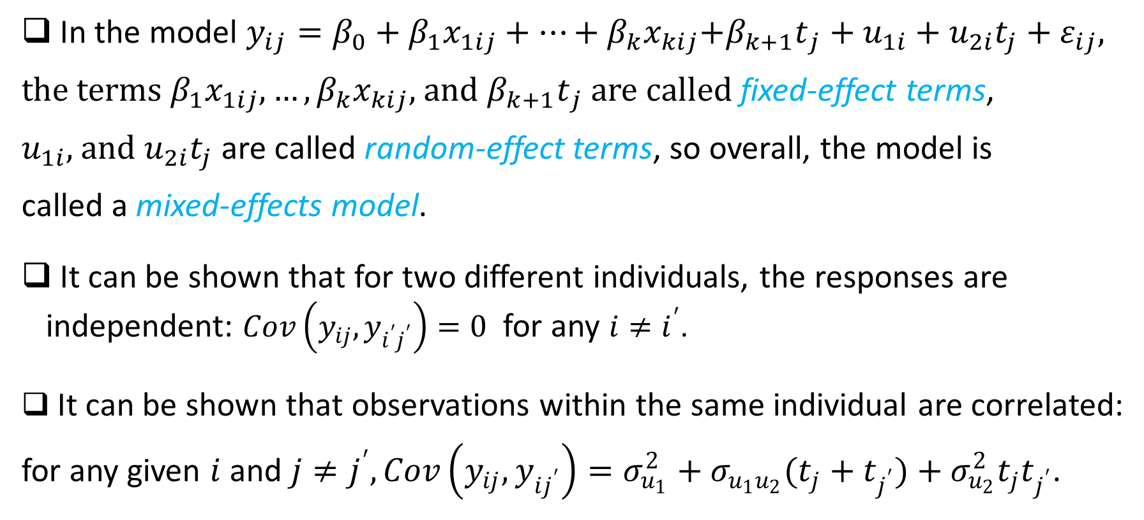
MIXED-EFFECTS MODEL FOR NORMAL RESPONSE: Mathematics Explained (Continued)
In the model $y_{ij}=β_{0}+β_{1}x_{1ij}+…+{β_{k}x}_{kij}{{+β}_{k+1}t}_{j}+u_{1i}+u_{2i}t_{j}+ε_{ij},$
the terms $β_{1}x_{1ij},…,{β_{k}x}_{kij}$, and ${β_{k+1}t}_{j}$are called fixed-effect terms,
$u_{1i},$and $u_{2i}t_{j}$ are called random-effect terms, so overall, the model is
called a mixed-effects model.
It can be shown that for two different individuals, the responses are independent: $Cov\left(y_{ij}, y_{i^{′}j^{′}}\right)=0$ for any $i≠i^{′}$.
It can be shown that observations within the same individual are correlated:
for any given $i$and $j≠j^{′}, Cov\left(y_{ij}, y_{ij^{′}}\right)=σ_{u_{1}}^{2}+σ_{u_{1}u_{2}}{(t_{j}+t}_{j^{′}})+σ_{u_{2}}^{2}t_{j}t_{j^{′}}$.

Slide 8
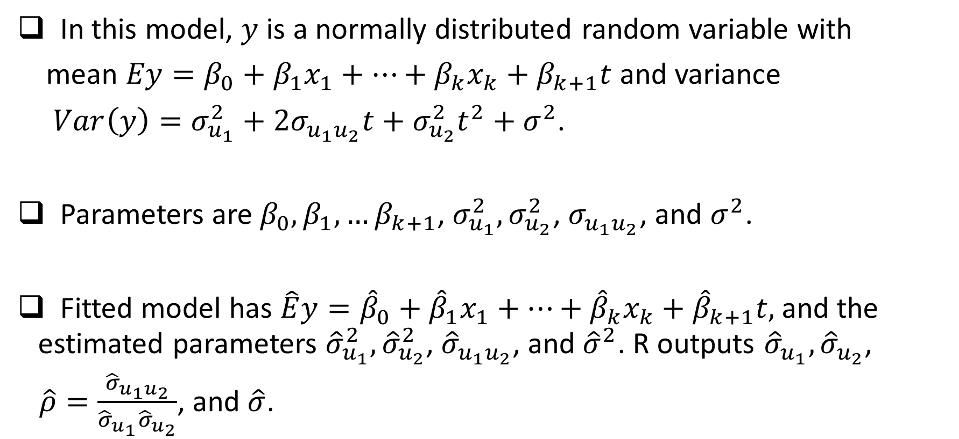
MIXED-EFFECTS MODEL FOR NORMAL RESPONSE: Mathematics Explained (Continued)
In this model, $y$ is a normally distributed random variable with
mean $Ey=β_{0}+{β_{1}x}_{1}+…+{β_{k}x}_{k}+β_{k+1}t$ and variance
$Var\left(y\right)=σ_{u_{1}}^{2}+2σ_{u_{1}u_{2}}t+σ_{u_{2}}^{2}t^{2}+σ^{2}$.
Parameters are $β_{0},β_{1},…β_{k+1}$, $σ_{u_{1}}^{2},σ_{u_{2}}^{2}$, $σ_{u_{1}u_{2}}$, and $σ^{2}$.
Fitted model has $\hat{E}y={\hat{β}}_{0}+{\hat{β}}_{1}x_{1}+…+{\hat{β}}_{k}x_{k}+{\hat{β}}_{k+1}t,$ and the estimated parameters ${\hat{σ}}_{u_{1}}^{2},{\hat{σ}}_{u_{2}}^{2}$, ${\hat{σ}}_{u_{1}u_{2}}$, and ${\hat{σ}}^{2}$. R outputs ${\hat{σ}}_{u_{1}},{\hat{σ}}_{u_{2}}$,
$\hat{ρ}=\frac{{\hat{σ}}_{u_{1}u_{2}}}{{\hat{σ}}_{u_{1}}{\hat{σ}}_{u_{2}}}$, and $\hat{σ}$.

Slide 9
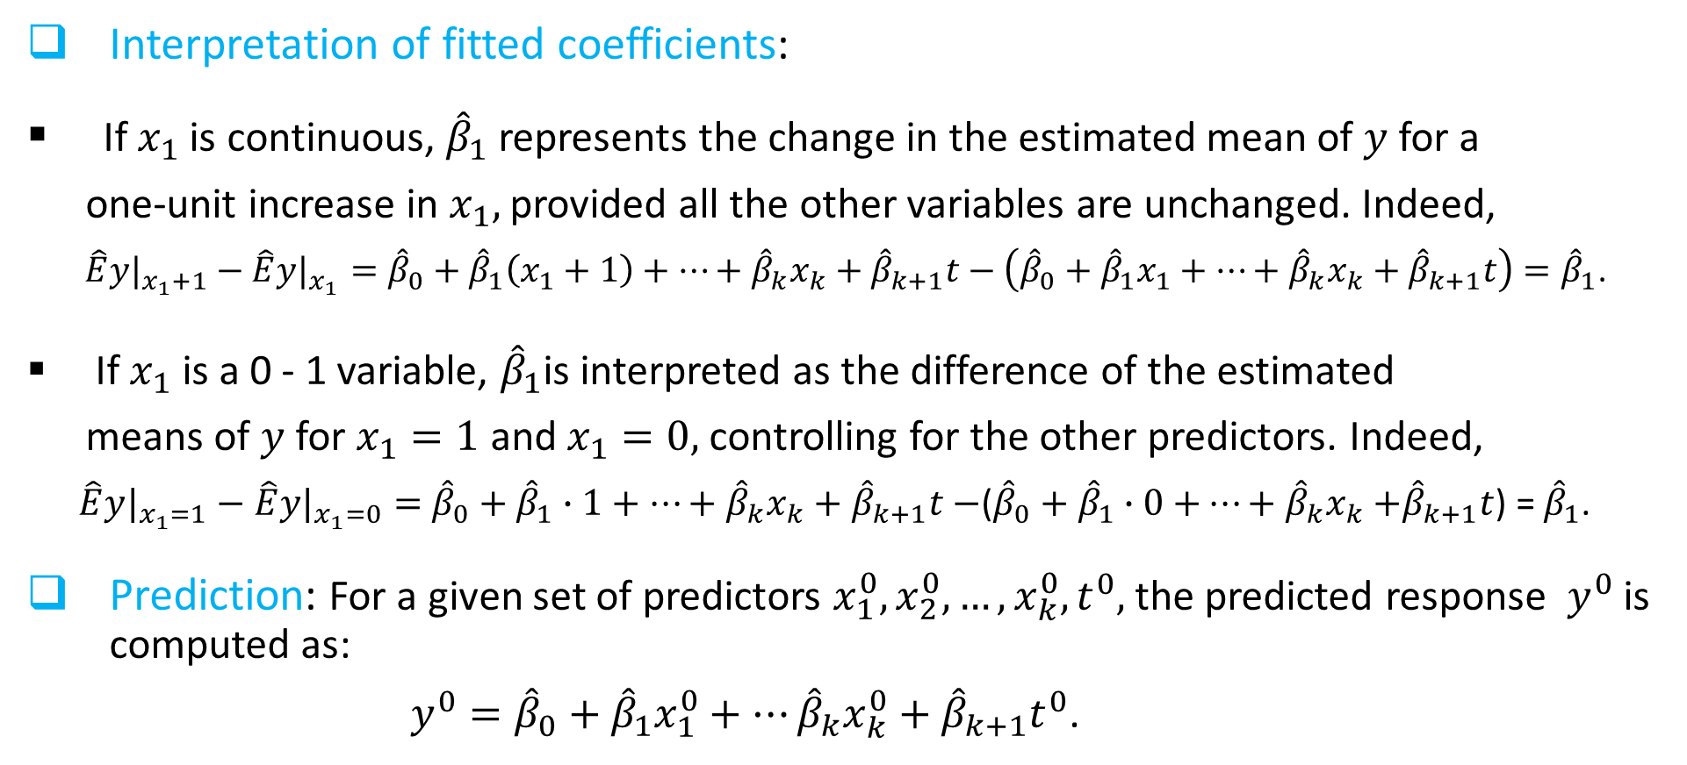
MIXED-EFFECTS MODEL FOR NORMAL RESPONSE: Mathematics Explained (Continued)
Interpretation of fitted coefficients:
If $x_{1}$ is continuous, ${\hat{β}}_{1}$represents the change in the estimated mean of $y$for a
one-unit increase in $x_{1},$provided all the other variables are unchanged. Indeed,
$\hat{E}{y|}_{x_{1}+1}−\hat{E}{y|}_{x_{1}}={\hat{β}}_{0}+{\hat{β}}_{1}\left(x_{1}+1\right)+…+{\hat{β}}_{k}x_{k}+{\hat{β}}_{k+1}t−\left({\hat{β}}_{0}+{\hat{β}}_{1}x_{1}+…+{\hat{β}}_{k}x_{k}+{\hat{β}}_{k+1}t\right)={\hat{β}}_{1}$.
If $x_{1}$ is a 0 - 1 variable, ${\hat{β}}_{1}$is interpreted as the difference of the estimated
means of $y$ for $x_{1}=1$ and $x_{1}=0,$controlling for the other predictors. Indeed,
$\hat{E}{y|}_{x_{1}=1}−\hat{E}{y|}_{x_{1}=0}=$ ${\hat{β}}_{0}+{\hat{β}}_{1}∙1+…+{\hat{β}}_{k}x_{k}+{\hat{β}}_{k+1}t−$(${\hat{β}}_{0}+{\hat{β}}_{1}∙0$ $+…+{\hat{β}}_{k}x_{k}$ $+{\hat{β}}_{k+1}t$) = ${\hat{β}}_{1}$.
Prediction: For a given set of predictors $x_{1}^{0}, x_{2}^{0}, …, x_{k}^{0}, t^{0},$the predicted response $y^{0}$ is computed as:
$y^{0}={\hat{β}}_{0}+{\hat{β}}_{1}x_{1}^{0}+…{\hat{β}}_{k}x_{k}^{0}+{\hat{β}}_{k+1}t^{0}$.

Slide 10
MIXED-EFFECTS MODEL FOR NORMAL RESPONSE: EXAMPLE
In a clinic, doctors are testing a certain cholesterol lowering medication. Patients' gender and age at the beginning of the study are recorded for 27 patients. The low-density lipoprotein (LDL) cholesterol levels are measured in all the patients at the baseline, and then at 6-, 9-, and 24-month visits. We use these data to develop a regression model that relates LDL level to the gender, age, and months into the study.

Slide 11
MIXED-EFFECTS MODEL FOR NORMAL RESPONSE: EXAMPLE
We create a long-form data.
cholesterol.data<- read.csv(file="C:/./LDLData.csv", header=TRUE, sep=",")
#creating long-form data set
library(reshape2)
longform.data<- melt(cholesterol.data, id.vars=c("id", "gender", "age"),
variable.name = "LDLmonth", value.name="LDL")
#creating numeric variable for time
month<- ifelse(longform.data$LDLmonth=="LDL0", 0, ifelse(longform.data$LDLmonth
=="LDL6", 6, ifelse(longform.data$LDLmonth=="LDL9",9,24)))

Slide 12
MIXED-EFFECTS MODEL FOR NORMAL RESPONSE: EXAMPLE
> longform.data
id gender age LDLmonth LDL
1 1 M 50 LDL0 73
2 2 F 72 LDL0 174
3 3 M 46 LDL0 85
4 4 F 71 LDL0 172
5 5 F 75 LDL0 186
< rows omitted >
104 23 M 62 LDL24 94
105 24 F 77 LDL24 155
106 25 M 55 LDL24 78
107 26 F 74 LDL24 111
108 27 F 79 LDL24 145
#creating numeric variable for time
month<- ifelse(longform.data$LDLmonth=="LDL0", 0, ifelse(longform.data$LDLmonth
=="LDL6", 6, ifelse(longform.data$LDLmonth=="LDL9",9,24)))
> month
[1] 0 0 0 0 0 0 0 0 0 0 0 0 0 0 0 0 0 0 0 0 0 0 0
[24] 0 0 0 0 6 6 6 6 6 6 6 6 6 6 6 6 6 6 6 6 6 6 6
[47] 6 6 6 6 6 6 6 6 9 9 9 9 9 9 9 9 9 9 9 9 9 9 9
[70] 9 9 9 9 9 9 9 9 9 9 9 9 24 24 24 24 24 24 24 24
[93] 24 24 24 24 24 24 24 24 24 24 24 24 24 24 24 24

Slide 13
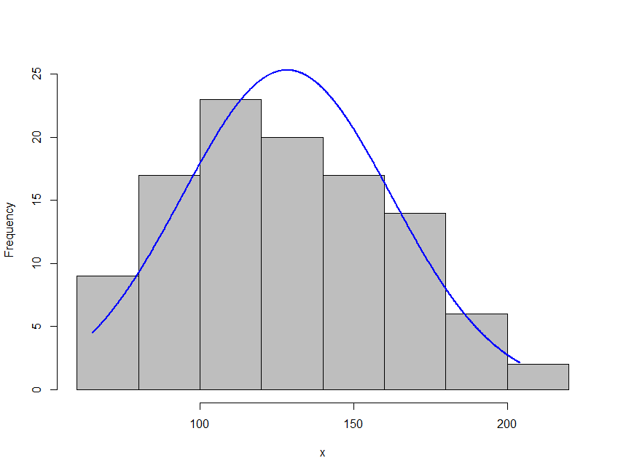
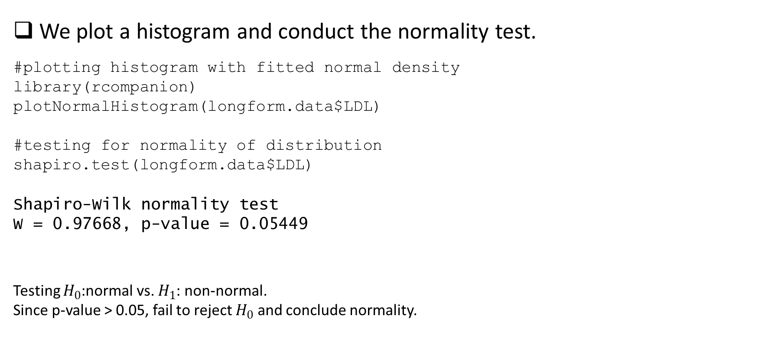
MIXED-EFFECTS MODEL FOR NORMAL RESPONSE: EXAMPLE
We plot a histogram and conduct the normality test.
#plotting histogram with fitted normal density
library(rcompanion)
plotNormalHistogram(longform.data$LDL)
#testing for normality of distribution
shapiro.test(longform.data$LDL)
Shapiro-Wilk normality test
W = 0.97668, p-value = 0.05449
Testing $H_{0}$:normal vs. $H_{1}$: non-normal.
Since p-value > 0.05, fail to reject $H_{0}$ and conclude normality.

Slide 14
MIXED-EFFECTS MODEL FOR NORMAL RESPONSE: EXAMPLE
We fit the model.
#fitting random slope and intercept model
library(nlme)
summary(fitted.model<- lme(LDL ~ gender+age+month,
random =~ 1+month|id, control=lmeControl(opt="optim"), data=longform.data))
Random effects:
StdDev Corr
(Intercept) 22.807 (Intr)
month 0.886 -0.812
Residual 8.358
Fixed effects:
Value Std.Error DF t-value p-value
(Intercept) 94.827 23.379 80 4.056 0.0001
genderM -29.811 6.972 24 -4.276 0.0003
age 0.920 0.337 24 2.732 0.0116
month -1.096 0.193 80 -5.671 0.0000

Slide 15
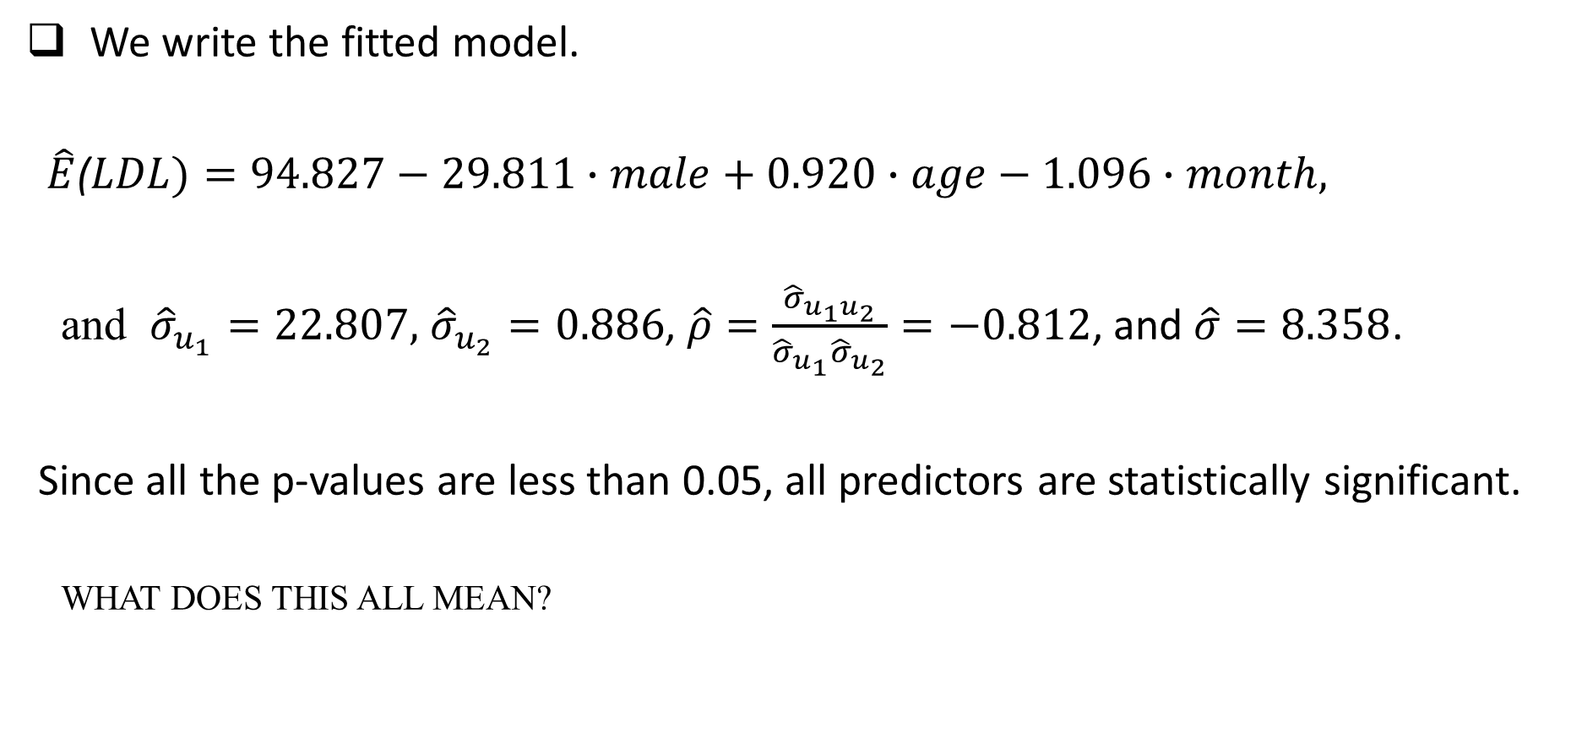
MIXED-EFFECTS MODEL FOR NORMAL RESPONSE: EXAMPLE
We write the fitted model.
$\hat{E}$($LDL)=94.827−29.811∙male+0.920∙age−1.096∙month,$
and ${\hat{σ}}_{u_{1}}=22.807,$ ${\hat{σ}}_{u_{2}}=0.886$, $\hat{ρ}=\frac{{\hat{σ}}_{u_{1}u_{2}}}{{\hat{σ}}_{u_{1}}{\hat{σ}}_{u_{2}}}=−0.812$, and $\hat{σ}=8.358$.
Since all the p-values are less than 0.05, all predictors are statistically significant.
WHAT DOES THIS ALL MEAN?

Slide 16
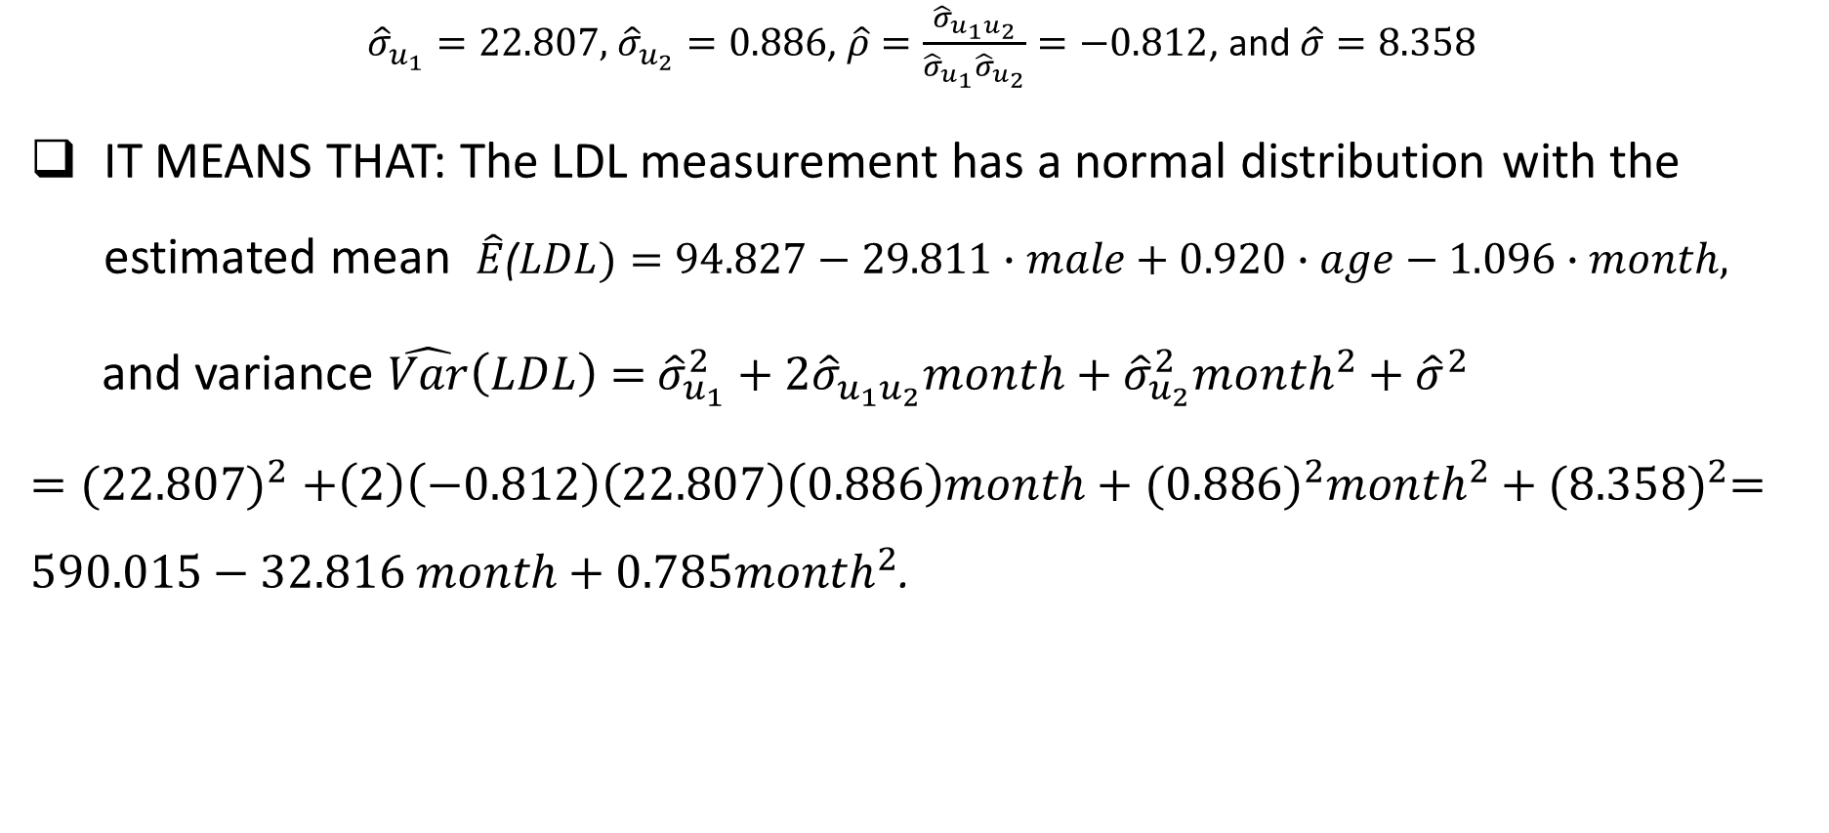
MIXED-EFFECTS MODEL FOR NORMAL RESPONSE: EXAMPLE
${\hat{σ}}_{u_{1}}=22.807,$ ${\hat{σ}}_{u_{2}}=0.886$, $\hat{ρ}=\frac{{\hat{σ}}_{u_{1}u_{2}}}{{\hat{σ}}_{u_{1}}{\hat{σ}}_{u_{2}}}=−0.812$, and $\hat{σ}=8.358$
IT MEANS THAT: The LDL measurement has a normal distribution with the estimated mean $\hat{E}$($LDL)=94.827−29.811∙male+0.920∙age−1.096∙month,$
and variance $\hat{Var}\left(LDL\right)=$ ${\hat{σ}}_{u_{1}}^{2}+2{\hat{σ}}_{u_{1}u_{2}}month+{\hat{σ}}_{u_{2}}^{2}{month}^{2}+{\hat{σ}}^{2}$
${=(22.807)}^{2}+\left(2\right)\left(−0.812\right)\left(22.807\right)\left(0.886\right)month+{(0.886)}^{2}{month}^{2}+{(8.358)}^{2}=590.015−32.816 month+0.785{month}^{2}$.

Slide 17
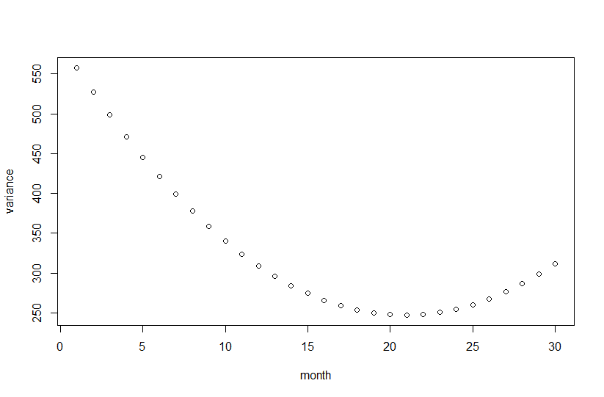
MIXED-EFFECTS MODEL FOR NORMAL RESPONSE: : EXAMPLE
We plot the variance against month.
variance<- function(t) {
590.015-32.816*t+0.785*t^2
}
t<- 1:30
plot(t,variance(t), xlab="month",
ylab="variance")
We see that variance decreases
between 0 and 24 months.

Slide 18
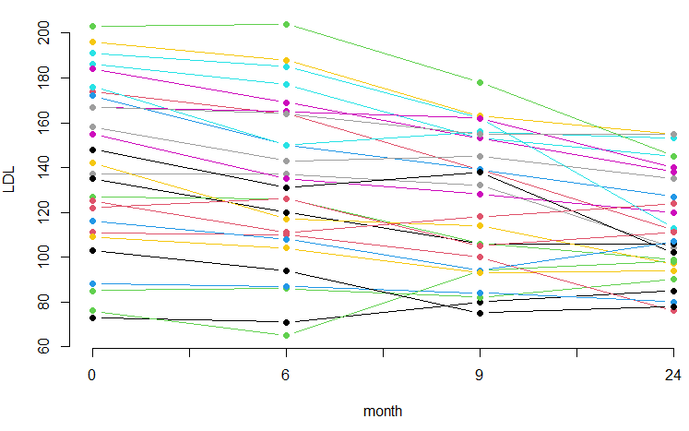
MIXED-EFFECTS MODEL FOR NORMAL RESPONSE: EXAMPLE
We plot individual profiles (LDL against months for each of 27 patients).
tr.data<- t(cholesterol.data)[-(1:3),]
matplot(tr.data, type="b", pch=16, lty=1,
col=1:27, axes=FALSE, ylab="LDL",
xlab="month")
xticks=c("0", "", "6", "", "9", "", "24")
axis(1,at=seq(1,4,0.5),labels=xticks)
axis(2)
We see that variance decreases
between 0 and 24 months.

Slide 19
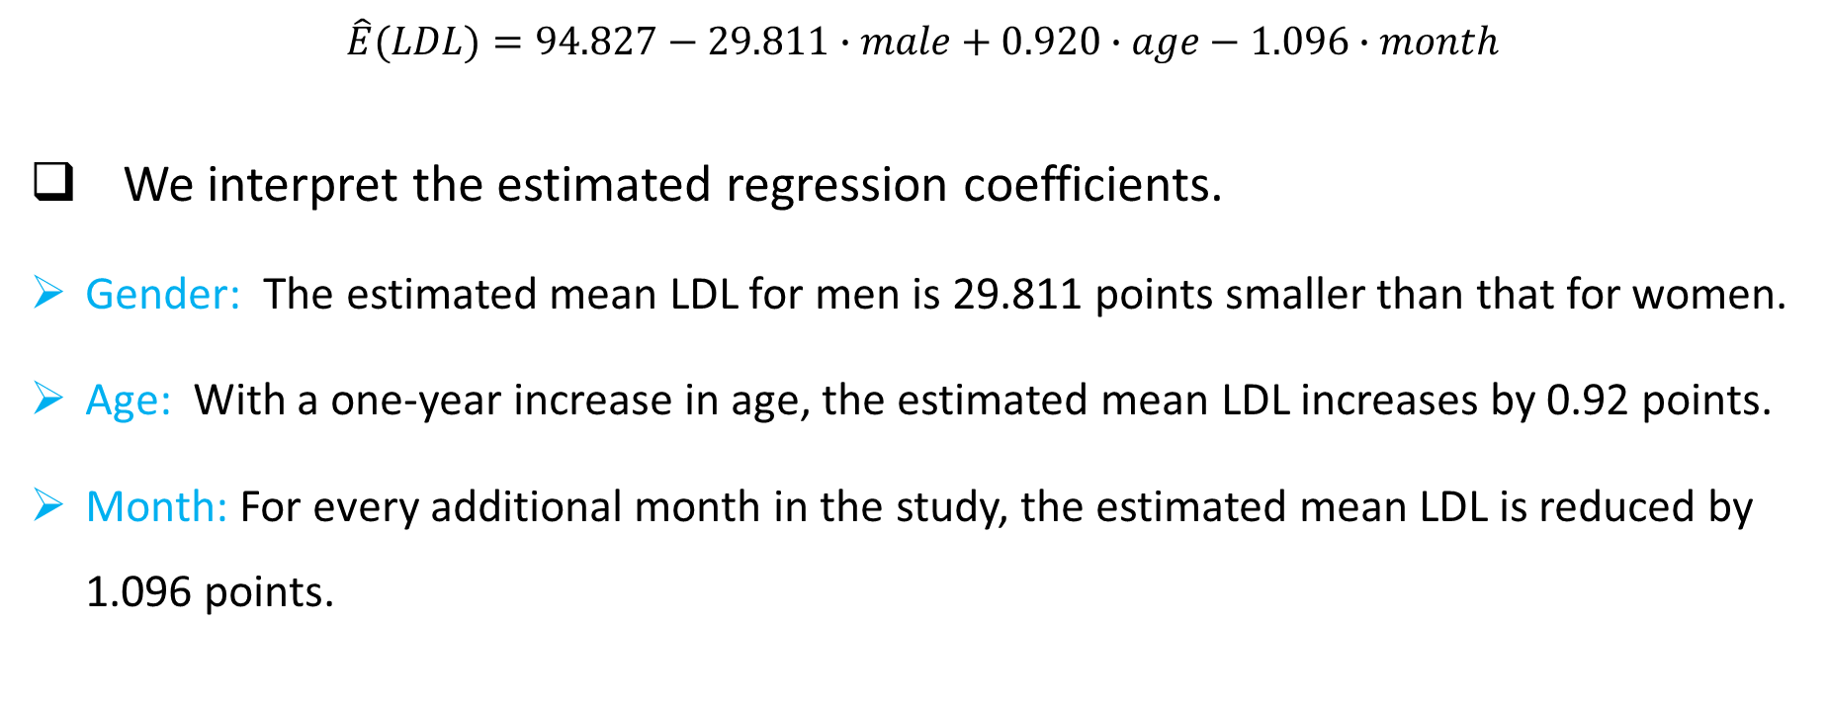
MIXED-EFFECTS MODEL FOR NORMAL RESPONSE: EXAMPLE
$\hat{E}(LDL)=94.827−29.811∙male+0.920∙age−1.096∙month$
We interpret the estimated regression coefficients.
Gender: The estimated mean LDL for men is 29.811 points smaller than that for women.
Age: With a one-year increase in age, the estimated mean LDL increases by 0.92 points.
Month: For every additional month in the study, the estimated mean LDL is reduced by 1.096 points.

Slide 20
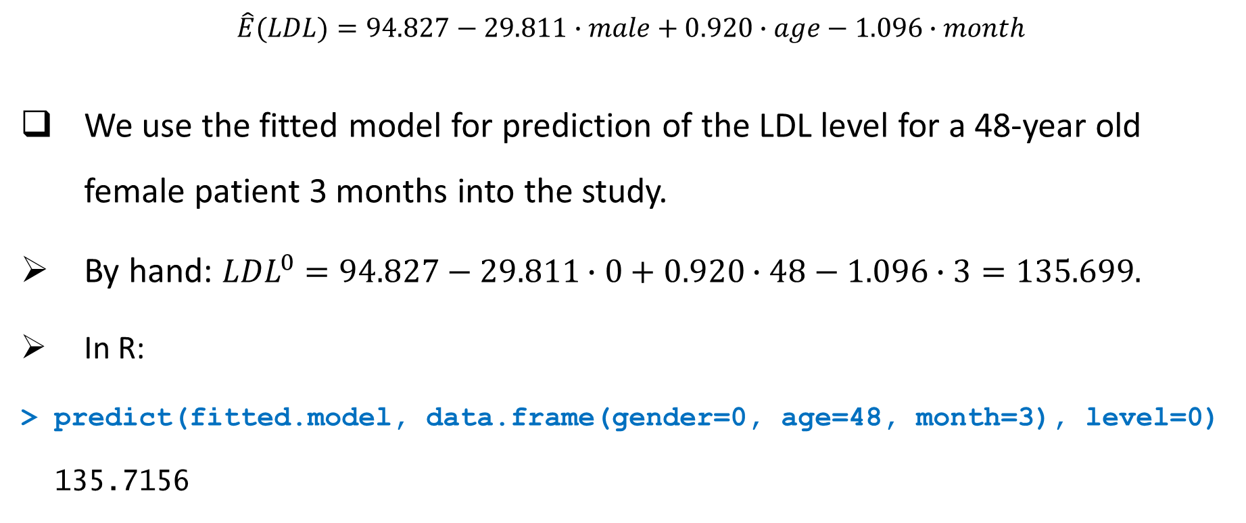
MIXED-EFFECTS MODEL FOR NORMAL RESPONSE: EXAMPLE
$\hat{E}(LDL)=94.827−29.811∙male+0.920∙age−1.096∙month$
We use the fitted model for prediction of the LDL level for a 48-year old female patient 3 months into the study.
By hand: ${LDL}^{0}=94.827−29.811∙0+0.920∙48−1.096∙3=135.699.$
In R:
> predict(fitted.model, data.frame(gender=0, age=48, month=3), level=0)
135.7156

Slide 21
MIXED-EFFECTS MODEL FOR NORMAL RESPONSE: EXERCISE
Measurements were taken on 20 people involved in a physical fitness course. The data contain participants' gender, age, oxygen intake (in ml per kg body weight per minute), run time (time to run 1 mile, in minutes), and pulse (average heart rate while running). The running was done under three different conditions: the first one on a treadmill, the second one on an indoor running track, and the third one on an outdoor running track. Use the longform data to answer the following questions:
(a) Check that pulse has a normal distribution. Construct a histogram and conduct normality tests.
(b) Run a random slope and intercept regression model for pulse. Write down the fitted model.
(c) Discuss significance of predictors at the 5% level. Interpret estimated significant regression coefficients.
(d) Predict an average heart rate for a 36-year-old woman who is running on a treadmill, if her oxygen intake is 40.2 units, and her run time is 10.3 minutes per mile.

Slide 22
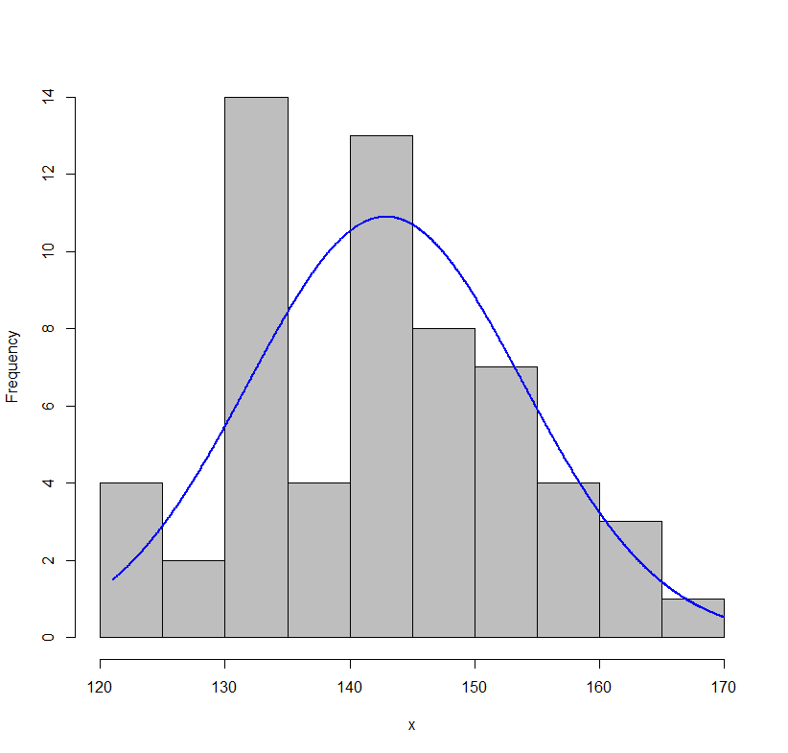
MIXED-EFFECTS MODEL FOR NORMAL RESPONSE: EXERCISE SOLUTION
(a) Check that pulse has a normal distribution. Construct a histogram and conduct normality tests.
library(rcompanion)
plotNormalHistogram(longform.data$pulse)
shapiro.test(longform.data$pulse)
Shapiro-Wilk normality test
W = 0.98398, p-value = 0.6173

Slide 23
MIXED-EFFECTS MODEL FOR NORMAL RESPONSE: EXERCISE SOLUTION
(b) Run a random slope and intercept regression model for pulse.
library(nlme)
summary(fitted.model<- lme(pulse ~ gender + age + oxygen
+ runtime + condition, random = ~ 1 + condition | id,
control=lmeControl(opt="optim"), data=longform.data))
Random effects:
StdDev Corr
(Intercept) 8.008 (Intr)
condition 6.091 -0.999
Residual 3.939
Significant are: gender, oxygen, and condition.
Fixed effects:
Value Std.Error DF t-value p-value
(Intercept) 174.492 10.075446 37 17.318583 0.0000
genderM -4.782 1.856487 17 -2.575887 0.0196
age -0.198 0.124495 17 -1.589534 0.1304
oxygen -0.909 0.167780 37 -5.419243 0.0000
runtime 0.614 0.591748 37 1.037967 0.3060
condition 6.194 1.531663 37 4.043907 0.0003

Slide 24
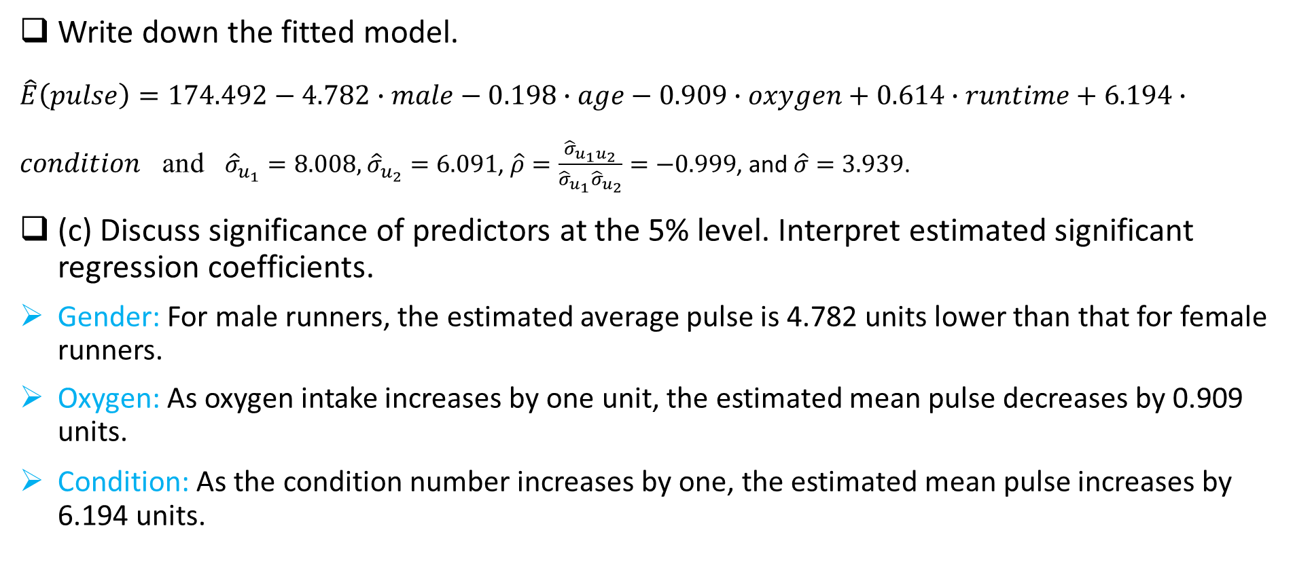
MIXED-EFFECTS MODEL FOR NORMAL RESPONSE: EXERCISE SOLUTION
Write down the fitted model.
$\hat{E}\left(pulse\right)=174.492−4.782∙male−0.198∙age−0.909∙oxygen+0.614∙runtime+6.194∙condition$ and ${\hat{σ}}_{u_{1}}=8.008,$ ${\hat{σ}}_{u_{2}}=6.091$, $\hat{ρ}=\frac{{\hat{σ}}_{u_{1}u_{2}}}{{\hat{σ}}_{u_{1}}{\hat{σ}}_{u_{2}}}=−0.999$, and $\hat{σ}=3.939$.
(c) Discuss significance of predictors at the 5% level. Interpret estimated significant regression coefficients.
Gender: For male runners, the estimated average pulse is 4.782 units lower than that for female runners.
Oxygen: As oxygen intake increases by one unit, the estimated mean pulse decreases by 0.909 units.
Condition: As the condition number increases by one, the estimated mean pulse increases by 6.194 units.

Slide 25
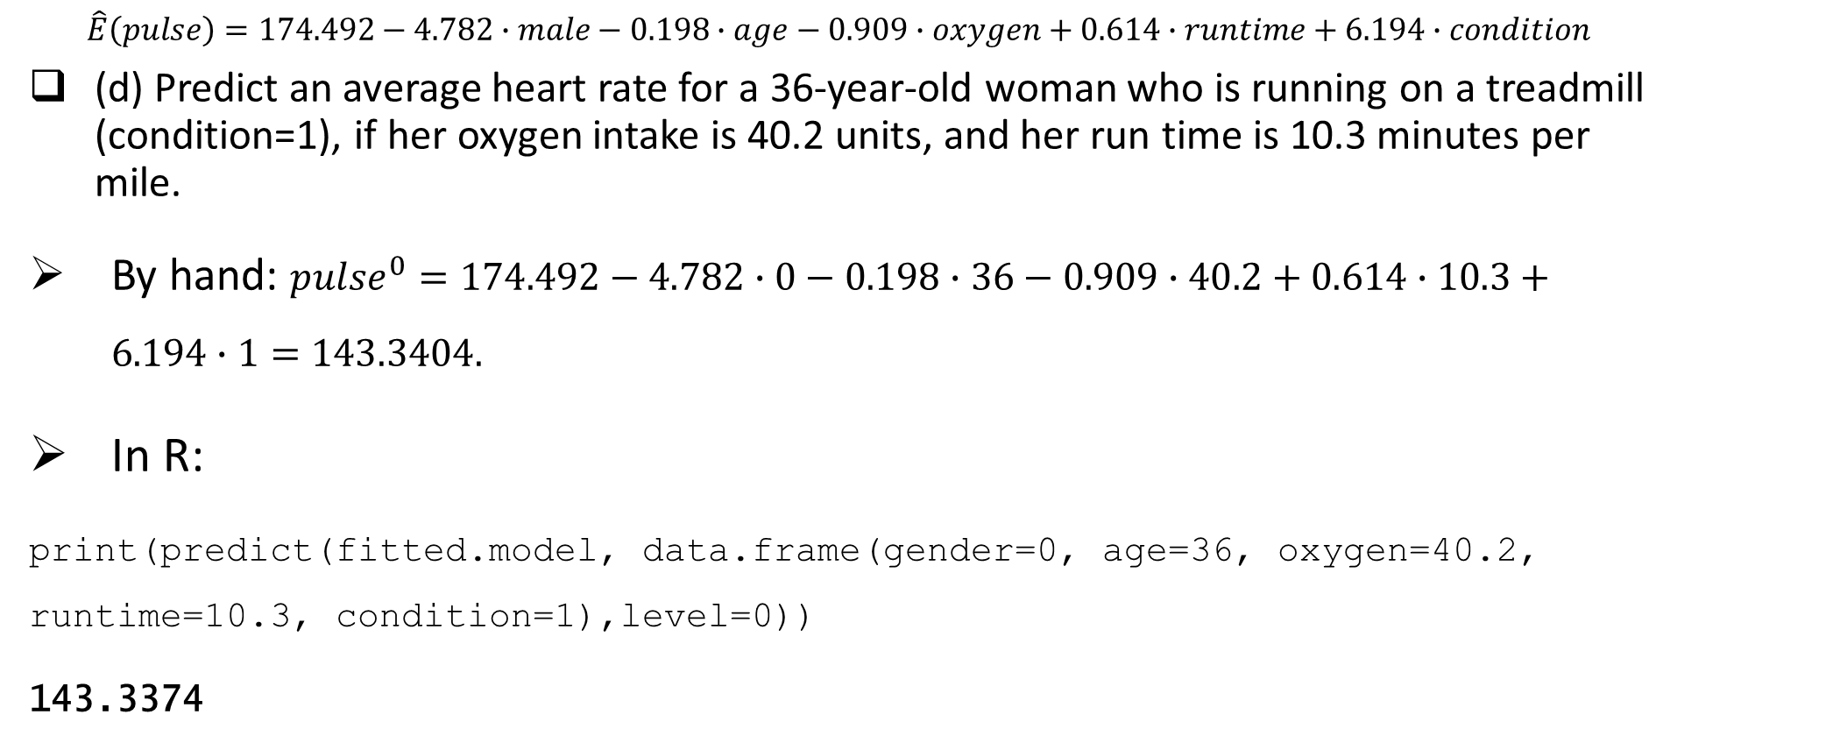
MIXED-EFFECTS MODEL FOR NORMAL RESPONSE: EXERCISE SOLUTION
$$\hat{E}\left(pulse\right)=174.492−4.782∙male−0.198∙age−0.909∙oxygen+0.614∙runtime+6.194∙condition$$
(d) Predict an average heart rate for a 36-year-old woman who is running on a treadmill (condition=1), if her oxygen intake is 40.2 units, and her run time is 10.3 minutes per mile.
By hand: ${pulse}^{0}=174.492−4.782∙0−0.198∙36−0.909∙40.2+0.614∙10.3+6.194∙1=143.3404.$
In R:
print(predict(fitted.model, data.frame(gender=0, age=36, oxygen=40.2, runtime=10.3, condition=1),level=0))
143.3374

Slide 26
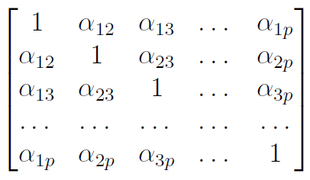
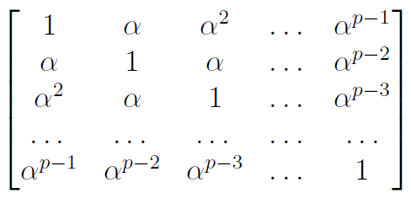

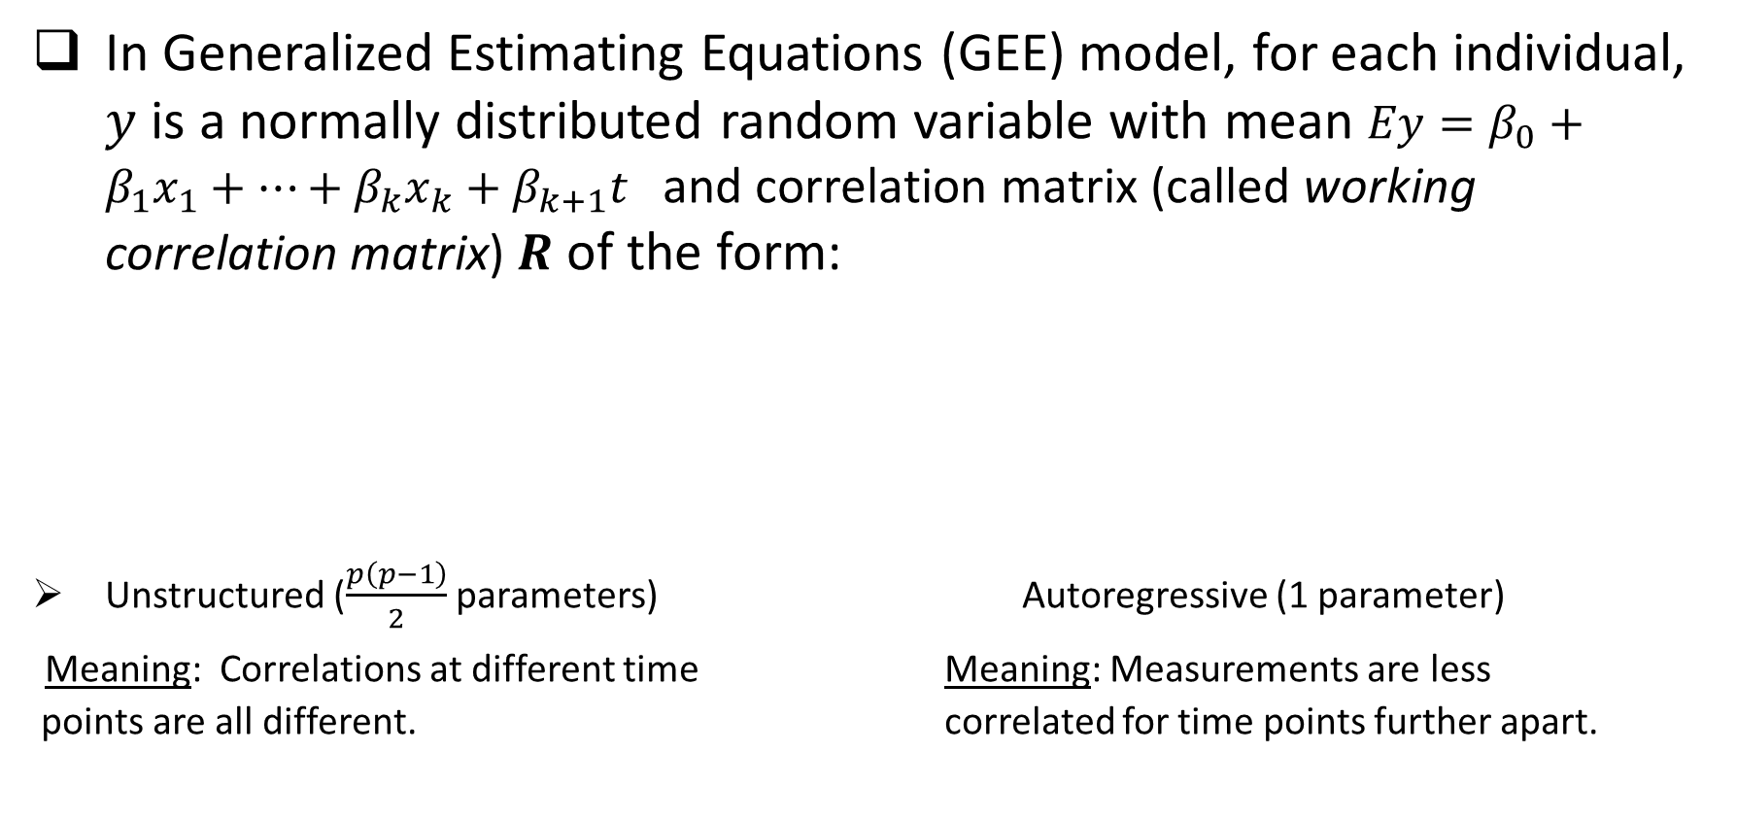
GENERALIZED ESTIMATING EQUATIONS MODEL FOR NORMAL RESPONSE: Mathematics Explained
In Generalized Estimating Equations (GEE) model, for each individual, $y$ is a normally distributed random variable with mean $Ey=β_{0}+{β_{1}x}_{1}+…+{β_{k}x}_{k}+β_{k+1}t$ and correlation matrix (called working correlation matrix) $R$ of the form:
Unstructured ($\frac{p\left(p−1\right)}{2}$ parameters) Autoregressive (1 parameter)
Meaning: Correlations at different time Meaning: Measurements are less
points are all different. correlated for time points further apart.

Slide 27
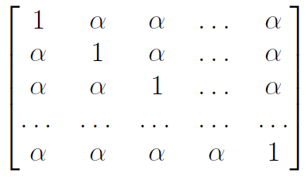
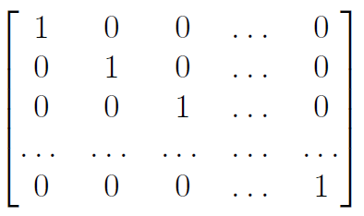
GENERALIZED ESTIMATING EQUATIONS MODEL FOR NORMAL RESPONSE: Mathematics Explained
Compound symmetric or exchangeable (1 parameter) Independent (0 parameters)
Meaning: Better works for conditions rather than time points. Meaning: not correlated.
The model that fits the data the best is chosen according to the quasi-likelihood under the independence (QIC) criterion. The model with the smallest QIC value is the winner. If there is a tie, pick either model.
Once the best-fitted model is chosen, we work with the estimated mean response for interpretation and prediction.

Slide 28
GEE MODEL FOR NORMAL RESPONSE: EXAMPLE
In our example, we use the GEE model to regress LDL on gender, age, and months into the study.
library(geepack)
#fitting GEE model with unstructured working correlation matrix
summary(un.fitted.model<- geeglm(LDL ~ gender + age + month, data=longform.data, id=id, family=gaussian(link="identity"), corstr="unstructured"))
Coefficients:
Estimate Std.err Wald Pr(>|W|)
(Intercept) 83.8023 22.0269 14.475 0.000142 ***
genderM -34.3149 6.5082 27.800 1.35e-07 ***
age 1.0077 0.2935 11.786 0.000597 ***
month -0.4788 0.4071 1.383 0.239578
Model is not reliable because one estimated correlation is above 1.
Estimated Correlation Parameters:
Estimate Std.err
alpha.1:2 1.1383 0.08577
alpha.1:3 0.6437 0.14531
alpha.1:4 0.1415 0.32543
alpha.2:3 0.6076 0.12888
alpha.2:4 0.1527 0.19510
alpha.3:4 0.4274 0.12394

Slide 29

GEE MODEL FOR NORMAL RESPONSE: EXAMPLE
#fitting GEE model with autoregressive working correlation matrix
summary(ar.fitted.model<- geeglm(LDL ~ gender + age + month, data=longform.data, id=id, family=gaussian(link="identity"), corstr="ar1"))
Coefficients:
Estimate Std.err Wald Pr(>|W|)
(Intercept) 90.171 22.964 15.4 8.6e-05 ***
genderM -36.463 6.942 27.6 1.5e-07 ***
age 1.032 0.319 10.4 0.0012 **
month -0.926 0.173 28.5 9.3e-08 ***
library(MuMIn)
QIC(ar.fitted.model)
123
$R$=
Estimated Correlation Parameters:
Estimate Std.err
alpha 0.701 0.0827

Slide 30
GEE MODEL FOR NORMAL RESPONSE: EXAMPLE
#fitting GEE model with compound symmetric (exchangeable) working correlation matrix
summary(cs.fitted.model<- geeglm(LDL ~ gender + age + month, data=longform.data, id=id, family=gaussian(link="identity"), corstr="exchangeable"))
Coefficients:
Estimate Std.err Wald Pr(>|W|)
(Intercept) 88.917 25.341 12.31 0.00045 ***
genderM -37.405 7.297 26.28 3.0e-07 ***
age 1.069 0.352 9.22 0.00239 **
month -1.096 0.190 33.39 7.5e-09 ***
QIC(cs.fitted.model)
126
$R$=
Estimated Correlation Parameters:
Estimate Std.err
alpha 0.582 0.0939

Slide 31
GEE MODEL FOR NORMAL RESPONSE: EXAMPLE
#fitting GEE model with independent working correlation matrix
summary(ind.fitted.model<- geeglm(LDL ~ gender + age + month, data=longform.data, id=id, family=gaussian(link="identity"), corstr="independence"))
Coefficients:
Estimate Std.err Wald Pr(>|W|)
(Intercept) 88.917 25.341 12.31 0.00045 ***
genderM -37.405 7.297 26.28 3.0e-07 ***
age 1.069 0.352 9.22 0.00239 **
month -1.096 0.190 33.39 7.5e-09 ***
QIC(ind.fitted.model)
126
$R$=

Slide 32

GEE MODEL FOR NORMAL RESPONSE: EXAMPLE
We fit the autoregressive model (it is the best-fitted model).
summary(geeglm(LDL ~ gender + age + month, data=longform.data, id=id, family=gaussian(link="identity"), corstr="ar1"))
Coefficients:
Estimate Std.err Wald Pr(>|W|)
(Intercept) 90.171 22.964 15.4 8.6e-05 ***
genderM -36.463 6.942 27.6 1.5e-07 ***
age 1.032 0.319 10.4 0.0012 **
month -0.926 0.173 28.5 9.3e-08 ***
Estimated Correlation Parameters:
Estimate Std.err
alpha 0.701 0.0827
The fitted model has the estimated mean $\hat{E}$($LDL)=90.171−36.463∙male+1.032∙age−0.926∙month$ and the estimated working correlation matrix
$\hat{R}=\left[\begin{aligned}1 \\ 0.701 \\ 0.491 \\ 0.344\end{aligned}\begin{aligned}0.701 \\ 1 \\ 0.701 \\ 0.491\end{aligned}\begin{aligned} 0.491 \\ 0.701 \\ 1 \\ 0.701\end{aligned}\begin{aligned}0.344 \\ 0.491 \\ 0.701 \\ 1\end{aligned}\right]$.
${(0.701)}^{2}=0.491, {(0.701)}^{3}=0.344$.
All predictors (gender, age, and month) are statistically significant at the 5% level.

Slide 33
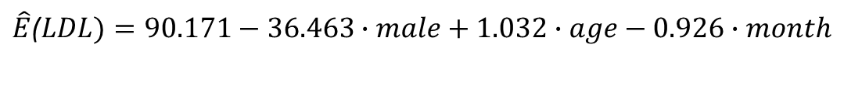
GEE MODEL FOR NORMAL RESPONSE: EXAMPLE
$\hat{E}$($LDL)=90.171−36.463∙male+1.032∙age−0.926∙month$
We interpret the estimated regression coefficients.
Gender: The estimated mean LDL for men is 36.463 points lower than that for women.
Age: With a one-year increase in age, the estimated mean LDL increases by 1.032 points.
Month: For every additional month in the study, the estimated mean LDL is reduced by 0.926 points.

Slide 34
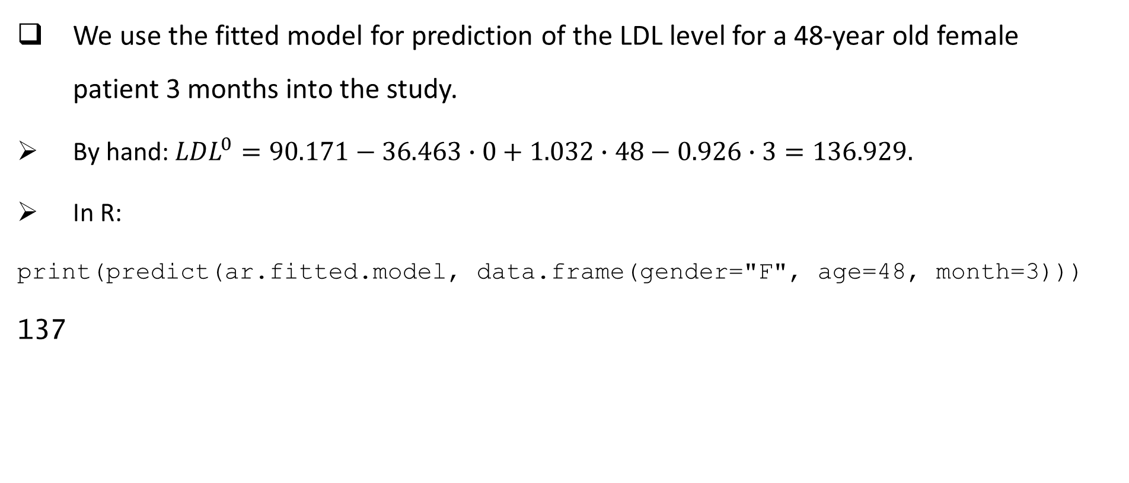
GEE MODEL FOR NORMAL RESPONSE: EXAMPLE
$\hat{E}$($LDL)=90.171−36.463∙male+1.032∙age−0.926∙month$
We use the fitted model for prediction of the LDL level for a 48-year old female patient 3 months into the study.
By hand: ${LDL}^{0}=90.171−36.463∙0+1.032∙48−0.926∙3=136.929.$
In R:
print(predict(ar.fitted.model, data.frame(gender="F", age=48, month=3)))
137

Slide 35
GEE MODEL FOR NORMAL RESPONSE: EXERCISE
Use the longform data in the fitness exercise to answer the following questions:
(a) Run GEE models with unstructured, autoregressive, compound symmetric, and independent working correlation matrices. Output QICs.
(b) Find the optimal model according to the QIC criterion.
(c) For the optimal model, write down the fitted model, estimating all parameters.
(d) Discuss significance of predictors and interpret significant estimated regression coefficients.
(e) Predict an average heart rate for a 36-year-old woman who is running on a treadmill, if her oxygen intake is 40.2 units, and her run time is 10.3 minutes per mile.

Slide 36
GEE MODEL FOR NORMAL RESPONSE: Exercise solution
Run GEE models.
#fitting GEE model with unstructured working correlation matrix
summary(un.fitted.model<- geeglm(pulse ~ gender + age + oxygen + runtime +condition,
data=longform.data, id=id, family = gaussian(link="identity"), corstr = "unstructured"))
Coefficients:
Estimate Std.err Wald Pr(>|W|)
(Intercept) 156.204 15.968 95.69 < 2e-16 ***
genderM -6.991 2.703 6.69 0.0097 **
age -0.232 0.132 3.08 0.0795 .
oxygen -0.373 0.217 2.95 0.0861 .
runtime 0.134 0.628 0.05 0.8315
condition 7.431 1.404 28.03 1.2e-07 ***
QIC(un.fitted.model)
72.91
Estimated Correlation Parameters:
Estimate Std.err
alpha.1:2 0.237 0.0946
alpha.1:3 -0.270 0.1600
alpha.2:3 -0.138 0.1881

Slide 37
GEE MODEL FOR NORMAL RESPONSE: Exercise solution
#fitting GEE model with autoregressive working correlation matrix
summary(ar.fitted.model<- geeglm(pulse ~ gender + age + oxygen + runtime + condition,
data=longform.data, id=id, family = gaussian(link="identity"), corstr = "ar1"))
Coefficients:
Estimate Std.err Wald Pr(>|W|)
(Intercept) 159.809 15.190 110.68 < 2e-16 ***
genderM -7.041 2.446 8.28 0.004 **
age -0.213 0.123 3.02 0.082 .
oxygen -0.438 0.218 4.04 0.044 *
runtime 0.104 0.566 0.03 0.855
condition 6.951 1.571 19.57 9.7e-06 ***
QIC(ar.fitted.model)
72.2
Estimated Correlation Parameters:
Estimate Std.err
alpha 0.0272 0.0688

Slide 38
GEE MODEL FOR NORMAL RESPONSE: Exercise solution
#fitting GEE model with compound symmetric (exchangeable) working correlation matrix
summary(cs.fitted.model<- geeglm(pulse ~ gender + age + oxygen + runtime + condition,
data=longform.data,id=id, family = gaussian(link="identity"), corstr = "exchangeable"))
Coefficients:
Estimate Std.err Wald Pr(>|W|)
(Intercept) 159.541 15.374 107.68 < 2e-16 ***
genderM -6.974 2.398 8.45 0.0036 **
age -0.216 0.119 3.29 0.0696 .
oxygen -0.441 0.206 4.59 0.0322 *
runtime 0.149 0.617 0.06 0.8085
condition 6.951 1.551 20.10 7.4e-06 ***
QIC(cs.fitted.model)
72.2
Estimated Correlation Parameters:
Estimate Std.err
alpha -0.0638 0.0947

Slide 39
GEE MODEL FOR NORMAL RESPONSE: Exercise solution
#fitting GEE model with independent working correlation matrix
summary(ind.fitted.model<- geeglm(pulse ~ gender + age + oxygen + runtime + condition,
data=longform.data,id=id, family = gaussian(link="identity"), corstr = "independence"))
Coefficients:
Estimate Std.err Wald Pr(>|W|)
(Intercept) 159.859 15.209 110.47 < 2e-16 ***
genderM -7.042 2.429 8.41 0.0037 **
age -0.213 0.122 3.06 0.0803 .
oxygen -0.440 0.215 4.19 0.0407 *
runtime 0.108 0.575 0.04 0.8510
condition 6.948 1.567 19.67 9.2e-06 ***
QIC(ind.fitted.model)
72.2
Either of the three models (autoregressive, compound symmetric , or independent) are the best-fitted models. Independent is the simplest.

Slide 40

GEE MODEL FOR NORMAL RESPONSE: Exercise solution
We fit the independent model.
summary(geeglm(pulse ~ gender + age + oxygen + runtime + condition, data=longform.data, id=id, family = gaussian(link="identity"), corstr = "independence"))
Coefficients:
Estimate Std.err Wald Pr(>|W|)
(Intercept) 159.859 15.209 110.47 < 2e-16 ***
genderM -7.042 2.429 8.41 0.0037 **
age -0.213 0.122 3.06 0.0803 .
oxygen -0.440 0.215 4.19 0.0407 *
runtime 0.108 0.575 0.04 0.8510
condition 6.948 1.567 19.67 9.2e-06 ***
The fitted model has $\hat{E}(pulse)=159.859−7.042∙male−0.213∙age−0.440∙oxygen+0.108∙runtime+6.948∙condition$and the working correlation matrix
$\hat{R}=\left[\begin{aligned}1 \\ 0 \\ 0 \\ 0\end{aligned}\begin{aligned} 0 \\ 1 \\ 0 \\ 0\end{aligned}\begin{aligned} 0 \\ 0 \\ 1 \\ 0\end{aligned} \begin{aligned} 0 \\ 0 \\ 0 \\ 1\end{aligned}\right]$.
Predictors that are statistically significant at the 5% level are gender, oxygen intake, and condition.

Slide 41
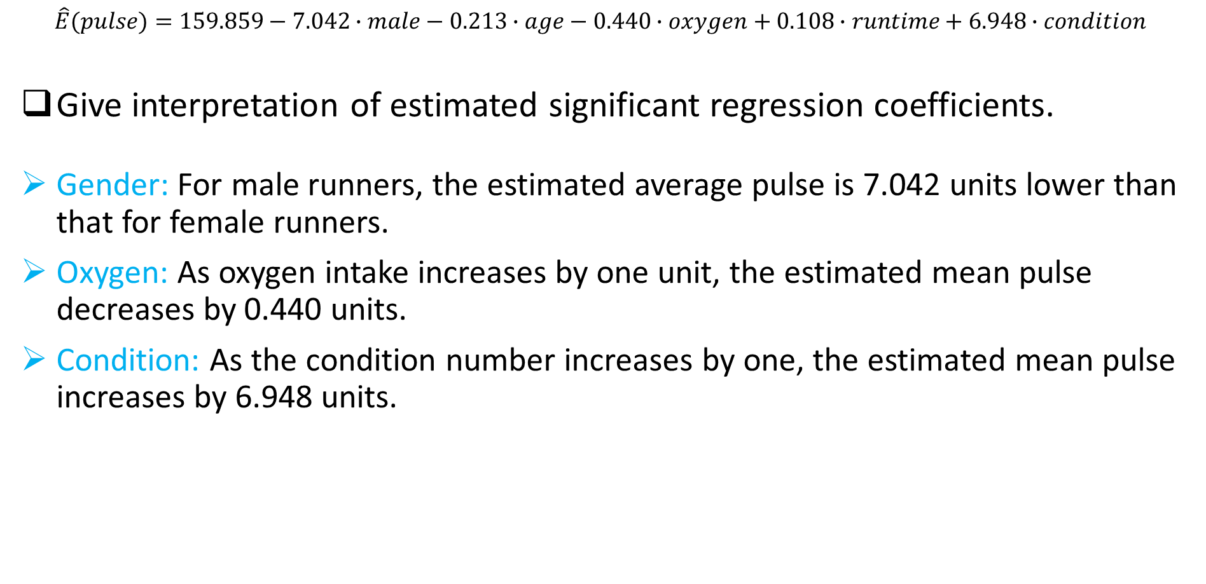
GEE MODEL FOR NORMAL RESPONSE: Exercise solution
$$\hat{E}(pulse)=159.859−7.042∙male−0.213∙age−0.440∙oxygen+0.108∙runtime+6.948∙condition$$
Give interpretation of estimated significant regression coefficients.
Gender: For male runners, the estimated average pulse is 7.042 units lower than that for female runners.
Oxygen: As oxygen intake increases by one unit, the estimated mean pulse decreases by 0.440 units.
Condition: As the condition number increases by one, the estimated mean pulse increases by 6.948 units.

Slide 42
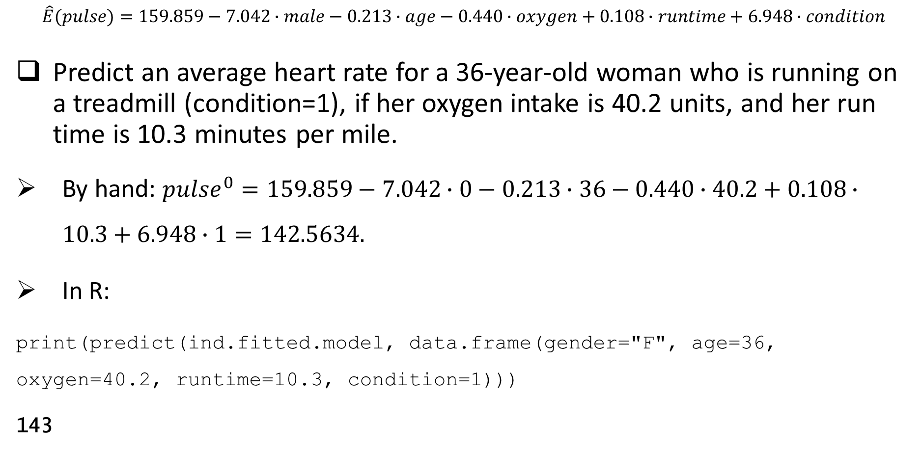
GEE MODEL FOR NORMAL RESPONSE: Exercise solution
$$\hat{E}(pulse)=159.859−7.042∙male−0.213∙age−0.440∙oxygen+0.108∙runtime+6.948∙condition$$
Predict an average heart rate for a 36-year-old woman who is running on a treadmill (condition=1), if her oxygen intake is 40.2 units, and her run time is 10.3 minutes per mile.
By hand: ${pulse}^{0}=159.859−7.042∙0−0.213∙36−0.440∙40.2+0.108∙10.3+6.948∙1=142.5634.$
In R:
print(predict(ind.fitted.model, data.frame(gender="F", age=36, oxygen=40.2, runtime=10.3, condition=1)))
143

Slide 43
ADDITIONAL EXERCISE
A health center conducted a study on efficacy of an intervention on weight loss. The intervention consisted of a lecture on proper nutrition and importance of exercising, followed by a cooking class. The study had a wait list control group. For each of the 34 study participants, the investigators recorded the group (intervention or control), gender (F/M), the typical length of daily exercise in the past week (in minutes), and BMI (in kg/m^2) at the beginning of the study, and at 1 and 3 months afterwards. Use the data set “WeightLossData.csv” to analyze the data.
(a) Verify normality of the response variable BMI by plotting the histogram and carrying out the normality test.
(b) Fit the random slope and intercept model. Present the fitted model and specify all estimated parameters. Discuss significance of the parameters at the 5% significance level.
(c) Give interpretation of the estimated significant beta coefficients. Is the intervention efficient?
(d) Compute the predicted BMI at 3 months for an intervention group male participant, if he exercises for 1 hour every day.

Slide 44
ADDITIONAL EXERCISE
(e) Fit the GEE models with unstructured, autoregressive, compound symmetric, and independent working correlation matrices of the response variable BMI.
(f) Choose the best-fitted model with respect to the QIC criterion.
(g) For the best-fitted model, write down the fitted model. Estimate all parameters. Discuss what predictors are significant at the 5% level.
(h) Interpret the estimated significant regression coefficients. Is the intervention efficient?
(i) Compute the predicted BMI at 3 months for an intervention group male participant, if he exercises for 1 hour every day.

Slide 45
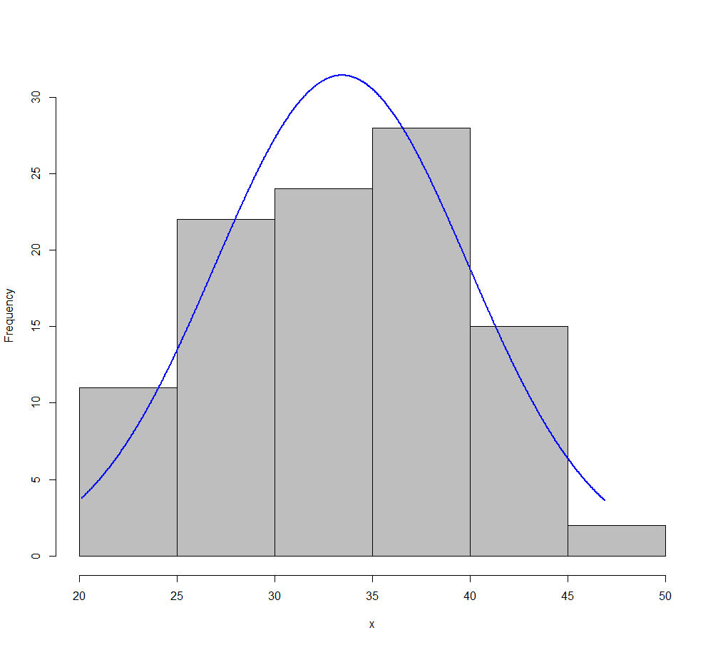
ADDITIONAL EXERCISE SOLUTION
(a) Verify normality of the response variable BMI by plotting the histogram and carrying out the normality test.
library(rcompanion)
plotNormalHistogram(longform.data$BMI)
shapiro.test(longform.data$BMI)
Shapiro-Wilk normality test
W = 0.98317, p-value = 0.2216

Slide 46
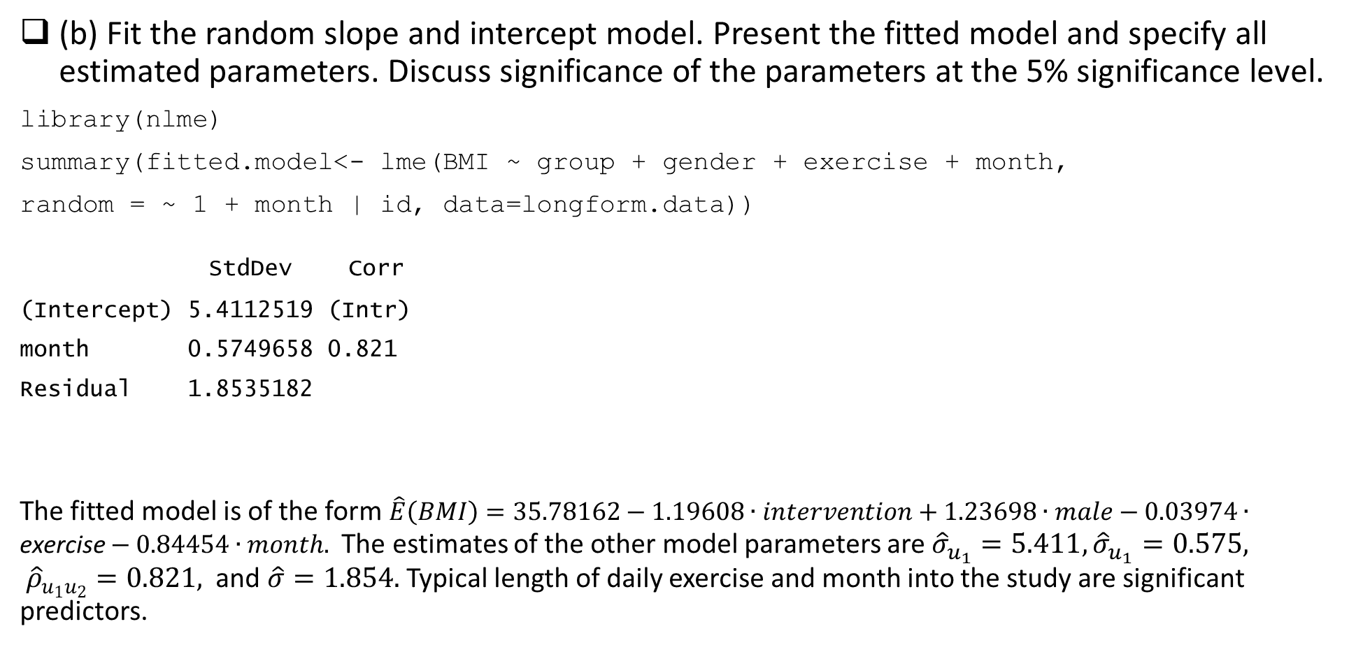
ADDITIONAL EXERCISE SOLUTION
(b) Fit the random slope and intercept model. Present the fitted model and specify all estimated parameters. Discuss significance of the parameters at the 5% significance level.
library(nlme)
summary(fitted.model<- lme(BMI ~ group + gender + exercise + month,
random = ~ 1 + month | id, data=longform.data))
StdDev Corr
(Intercept) 5.4112519 (Intr)
month 0.5749658 0.821
Residual 1.8535182
The fitted model is of the form $\hat{E}\left(BMI\right)=35.78162−1.19608∙intervention+1.23698∙male−0.03974∙\text{exercise}−0.84454∙month.$ The estimates of the other model parameters are ${\hat{σ}}_{u_{1}}=5.411,{\hat{σ}}_{u_{1}}=0.575, {\hat{ρ}}_{u_{1}u_{2}}=0.821,$ and $\hat{σ}=1.854.$ Typical length of daily exercise and month into the study are significant predictors.
Fixed effects:
Value Std.Error DF t-value p-value
(Intercept) 35.78162 1.5680426 66 22.819288 0.0000
groupInt -1.19608 1.8719456 31 -0.638949 0.5275
genderM 1.23698 1.8969761 31 0.652082 0.5192
exercise -0.03974 0.0112112 66 -3.544454 0.0007
month -0.84454 0.2028822 66 -4.162726 0.0001

Slide 47
ADDITIONAL EXERCISE SOLUTION
(c) Give interpretation of the estimated significant beta coefficients. Is the intervention efficient?
Exercise: As the length of daily exercise increases by one minute, the estimated average BMI decreases by 0.03974 units.
Month: It is estimated that the average BMI decreases by 0.84454 units for every additional month in the study.
Group is not a significant predictor, thus from the statistical point of view, the intervention is not efficient.

Slide 48
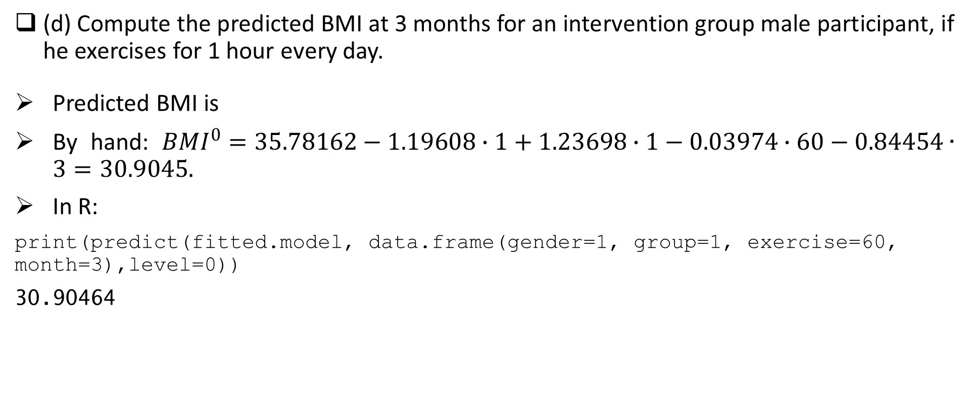
ADDITIONAL EXERCISE SOLUTION
(d) Compute the predicted BMI at 3 months for an intervention group male participant, if he exercises for 1 hour every day.
Predicted BMI is
By hand: ${BMI}^{0}=35.78162−1.19608∙1+1.23698∙1−0.03974∙60−0.84454∙3=30.9045.$
In R:
print(predict(fitted.model, data.frame(gender=1, group=1, exercise=60, month=3),level=0))
30.90464

Slide 49
ADDITIONAL EXERCISE SOLUTION
(e) Fit the GEE models with unstructured, autoregressive, compound symmetric, and independent working correlation matrices of the response variable BMI.
#fitting GEE model with unstructured working correlation matrix
summary(un.fitted.model<- geeglm(BMI ~ group + gender + exercise + month, data=longform.data, id=id, family=gaussian(link="identity"), corstr = "unstructured"))
Coefficients:
Estimate Std.err Wald Pr(>|W|)
(Intercept) 37.406687 1.796953 433.336 < 2e-16 ***
groupInt -3.898733 2.105776 3.428 0.0641 .
genderM 0.748395 2.029100 0.136 0.7123
exercise -0.048367 0.009774 24.486 7.48e-07 ***
month -0.766805 0.153825 24.850 6.20e-07 ***
Estimated Correlation Parameters:
Estimate Std.err
alpha.1:2 0.7600 0.12095
alpha.1:3 0.8422 0.12092
alpha.2:3 1.0617 0.05563
Unreliable model.

Slide 50
ADDITIONAL EXERCISE SOLUTION
#fitting GEE model with autoregressive working correlation matrix
summary(ar.fitted.model<- geeglm(BMI ~ group + gender + exercise + month, data=longform.data, id=id, family=gaussian(link="identity"), corstr = "ar1"))
Coefficients:
Estimate Std.err Wald Pr(>|W|)
(Intercept) 37.01575 1.73804 453.58 < 2e-16 ***
groupInt -4.09328 2.04978 3.99 0.046 *
genderM 0.90402 1.97902 0.21 0.648
exercise -0.02297 0.00489 22.09 2.6e-06 ***
month -0.96053 0.16435 34.16 5.1e-09 ***
QIC(ar.fitted.model)
115
Estimated Correlation Parameters:
Estimate Std.err
alpha 0.912 0.0556

Slide 51
ADDITIONAL EXERCISE SOLUTION
#fitting GEE model with compound symmetric working correlation matrix
summary(cs.fitted.model<- geeglm(BMI ~ group + gender + exercise + month, data=longform.data, id=id, family=gaussian(link="identity"), corstr = "exchangeable"))
Coefficients:
Estimate Std.err Wald Pr(>|W|)
(Intercept) 36.78987 1.77243 430.84 < 2e-16 ***
groupInt -3.57677 2.06691 2.99 0.084 .
genderM 0.99212 1.98382 0.25 0.617
exercise -0.02777 0.00574 23.37 1.3e-06 ***
month -0.95011 0.20191 22.14 2.5e-06 ***
QIC(cs.fitted.model)
115
Estimated Correlation Parameters:
Estimate Std.err
alpha 0.887 0.0651

Slide 52
ADDITIONAL EXERCISE SOLUTION
#fitting GEE model with independent working correlation matrix
summary(ind.fitted.model<- geeglm(BMI ~ group + gender + exercise + month, data=longform.data, id=id, family=gaussian(link="identity"), corstr = "independence"))
Coefficients:
Estimate Std.err Wald Pr(>|W|)
(Intercept) 36.3214 1.8095 402.92 < 2e-16 ***
groupInt -4.6539 1.9882 5.48 0.019 *
genderM 1.0787 1.9477 0.31 0.580
exercise 0.0250 0.0186 1.82 0.177
month -1.4161 0.2930 23.36 1.3e-06 ***
QIC(ind.fitted.model)
120

Slide 53
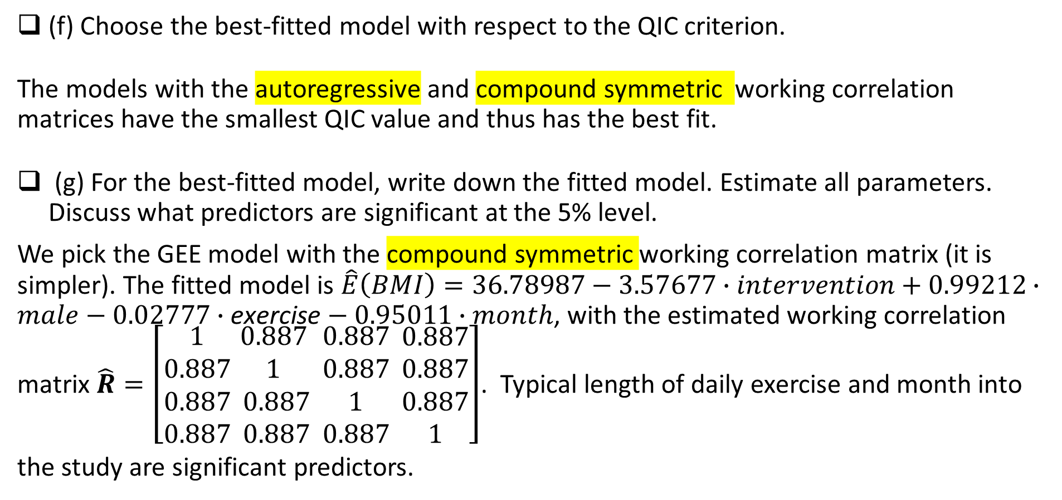
ADDITIONAL EXERCISE SOLUTION
(f) Choose the best-fitted model with respect to the QIC criterion.
The models with the autoregressive and compound symmetric working correlation matrices have the smallest QIC value and thus has the best fit.
(g) For the best-fitted model, write down the fitted model. Estimate all parameters. Discuss what predictors are significant at the 5% level.
We pick the GEE model with the compound symmetric working correlation matrix (it is simpler). The fitted model is $\hat{E}\left(BMI\right)=36.78987−3.57677∙intervention+0.99212∙male−0.02777∙\text{exercise}−0.95011∙month$, with the estimated working correlation matrix $\hat{R}=\left[\begin{aligned}1 \\ 0.887 \\ 0.887 \\ 0.887\end{aligned}\begin{aligned} 0.887 \\ 1 \\ 0.887 \\ 0.887\end{aligned}\begin{aligned} 0.887 \\ 0.887 \\ 1 \\ 0.887\end{aligned} \begin{aligned} 0.887 \\ 0.887 \\ 0.887 \\ 1\end{aligned}\right]$. Typical length of daily exercise and month into
the study are significant predictors.

Slide 54
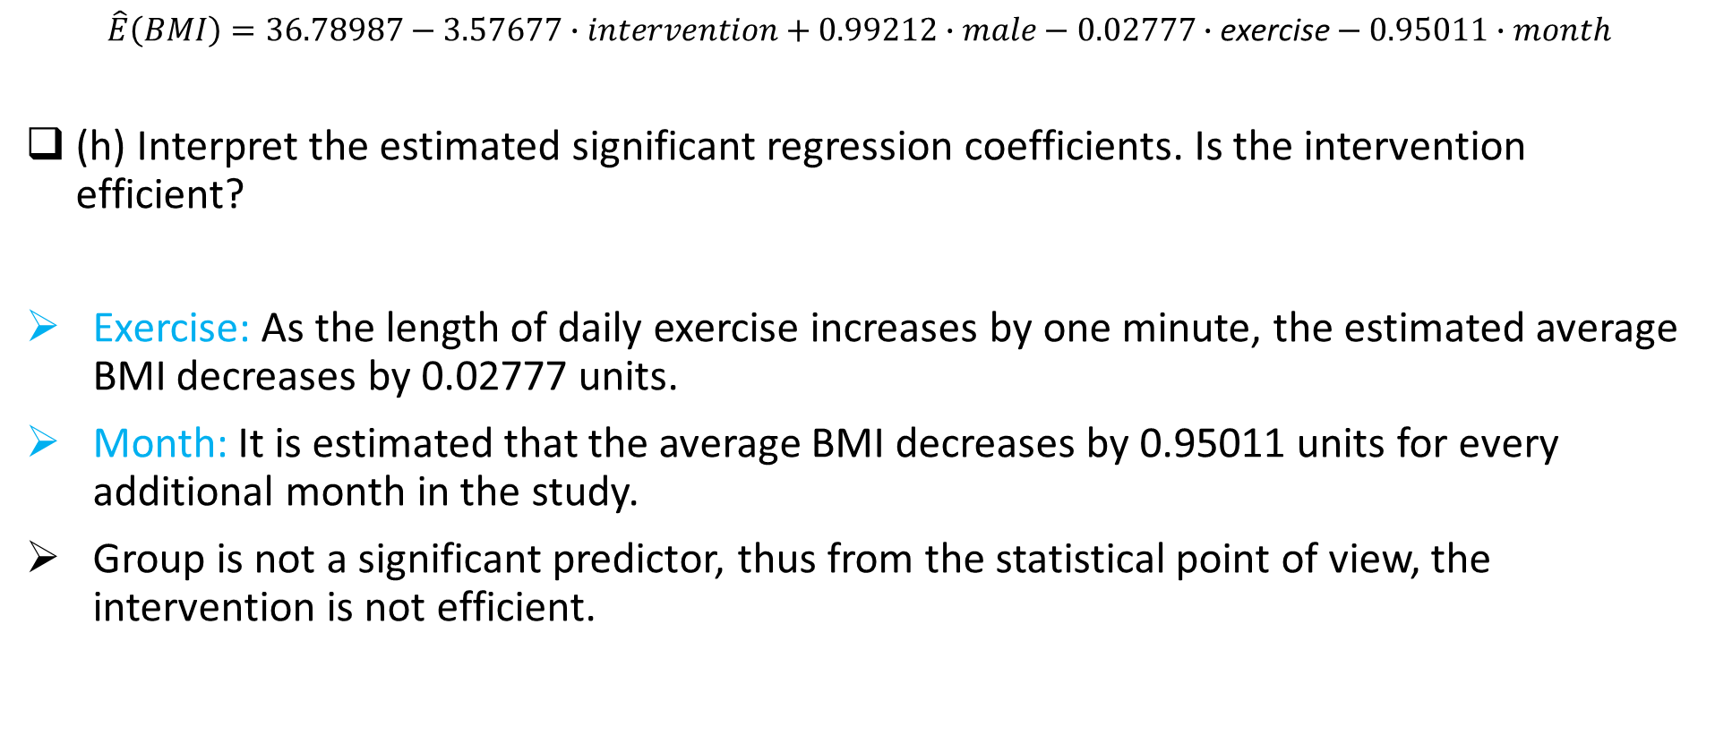
ADDITIONAL EXERCISE SOLUTION
$$\hat{E}\left(BMI\right)=36.78987−3.57677∙intervention+0.99212∙male−0.02777∙\text{exercise}−0.95011∙month$$
(h) Interpret the estimated significant regression coefficients. Is the intervention efficient?
Exercise: As the length of daily exercise increases by one minute, the estimated average BMI decreases by 0.02777 units.
Month: It is estimated that the average BMI decreases by 0.95011 units for every additional month in the study.
Group is not a significant predictor, thus from the statistical point of view, the intervention is not efficient.

Slide 55
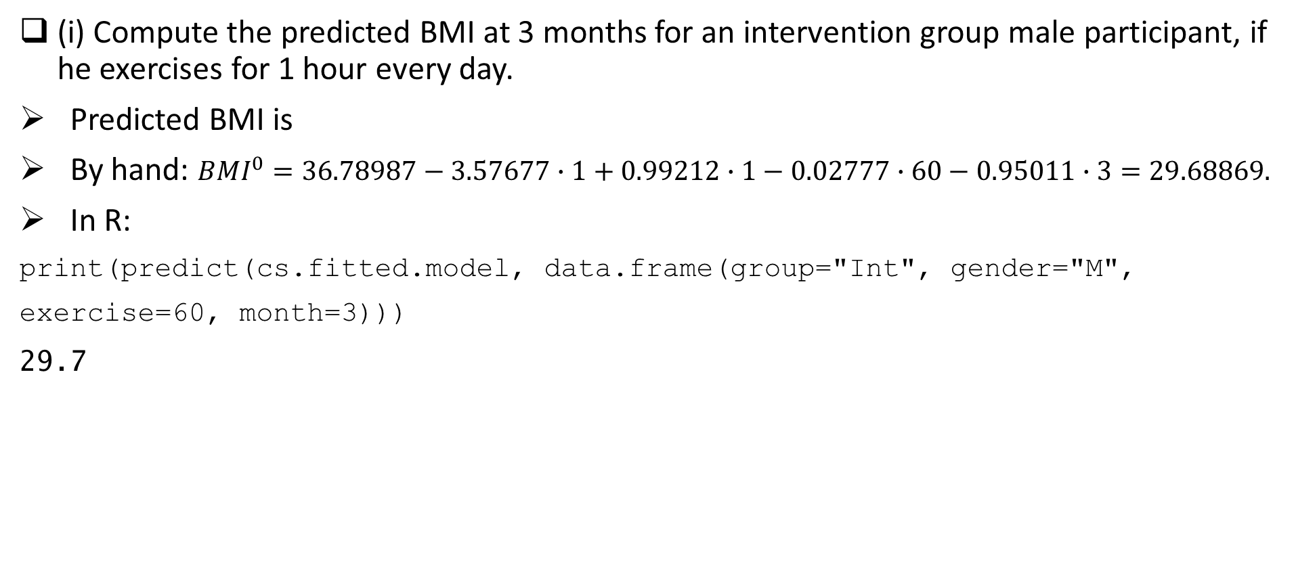
ADDITIONAL EXERCISE SOLUTION
(i) Compute the predicted BMI at 3 months for an intervention group male participant, if he exercises for 1 hour every day.
Predicted BMI is
By hand: ${BMI}^{0}=36.78987−3.57677∙1+0.99212∙1−0.02777∙60−0.95011∙3=29.68869.$
In R:
print(predict(cs.fitted.model, data.frame(group="Int", gender="M",
exercise=60, month=3)))
29.7

Slide 56


